Slide 1
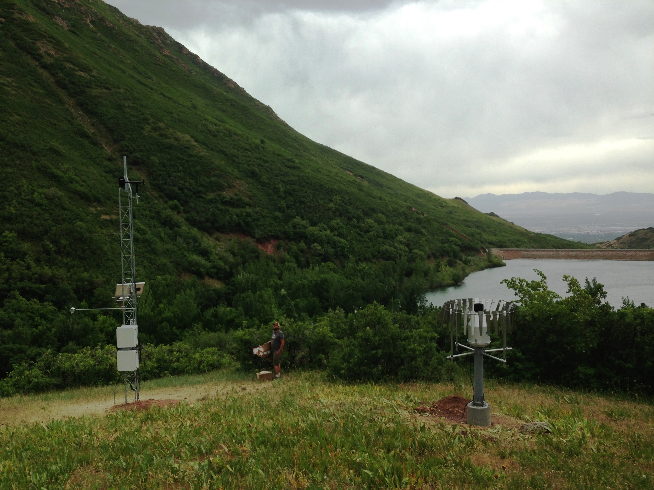



Streaming Sensor Data: Tools for Acquisition, Management, and Visualization
Amber Spackman Jones Jeffery S. Horsburgh • Stephanie L. Reeder Juan Caraballo • Denver Smith Zach Yoshikawa • Mario Matos
National Water Quality Monitoring Conference • Tampa, FL • May 5, 2016

Slide 2
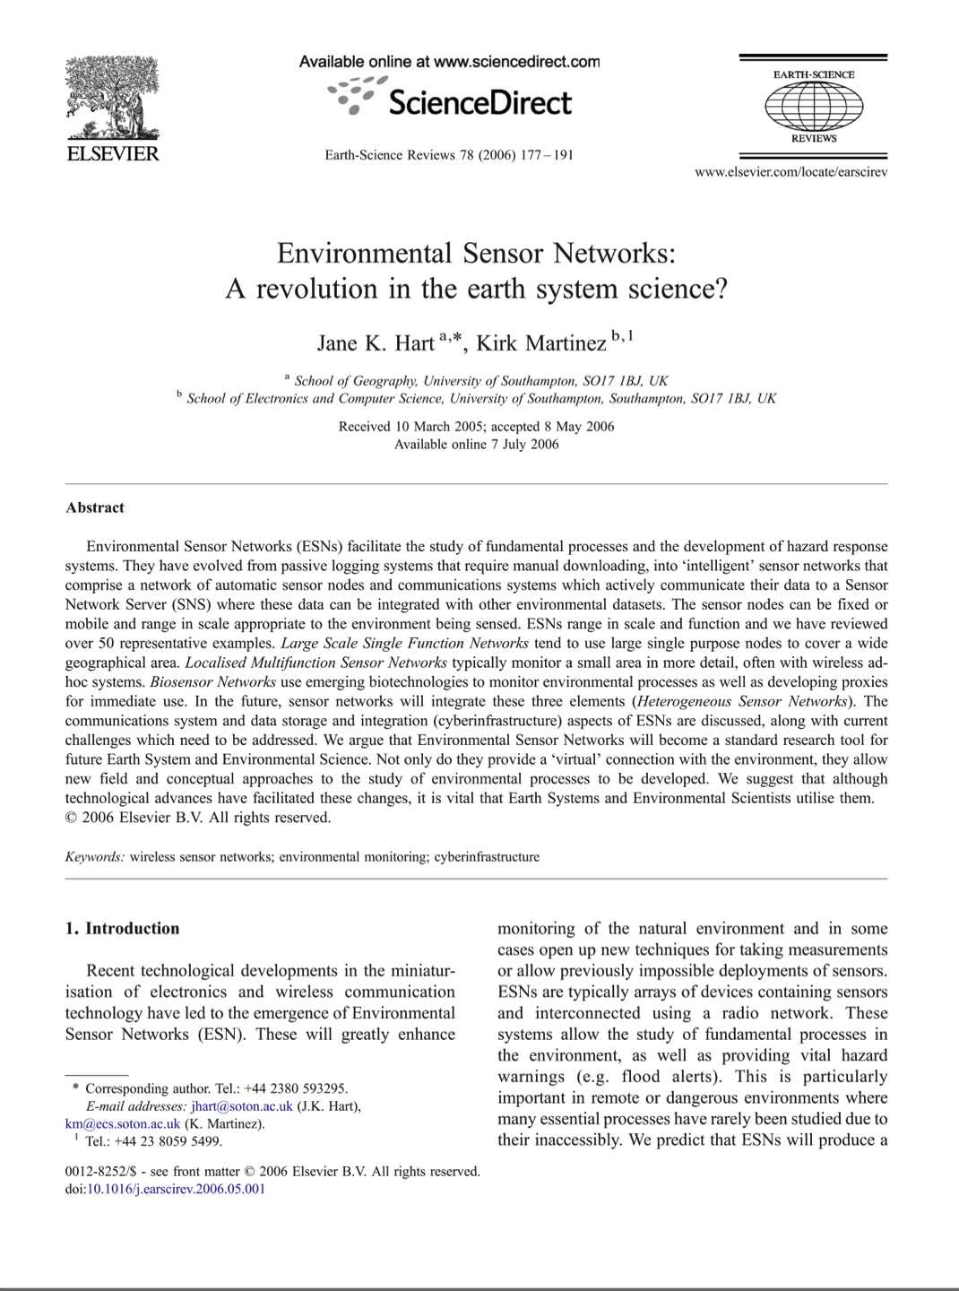
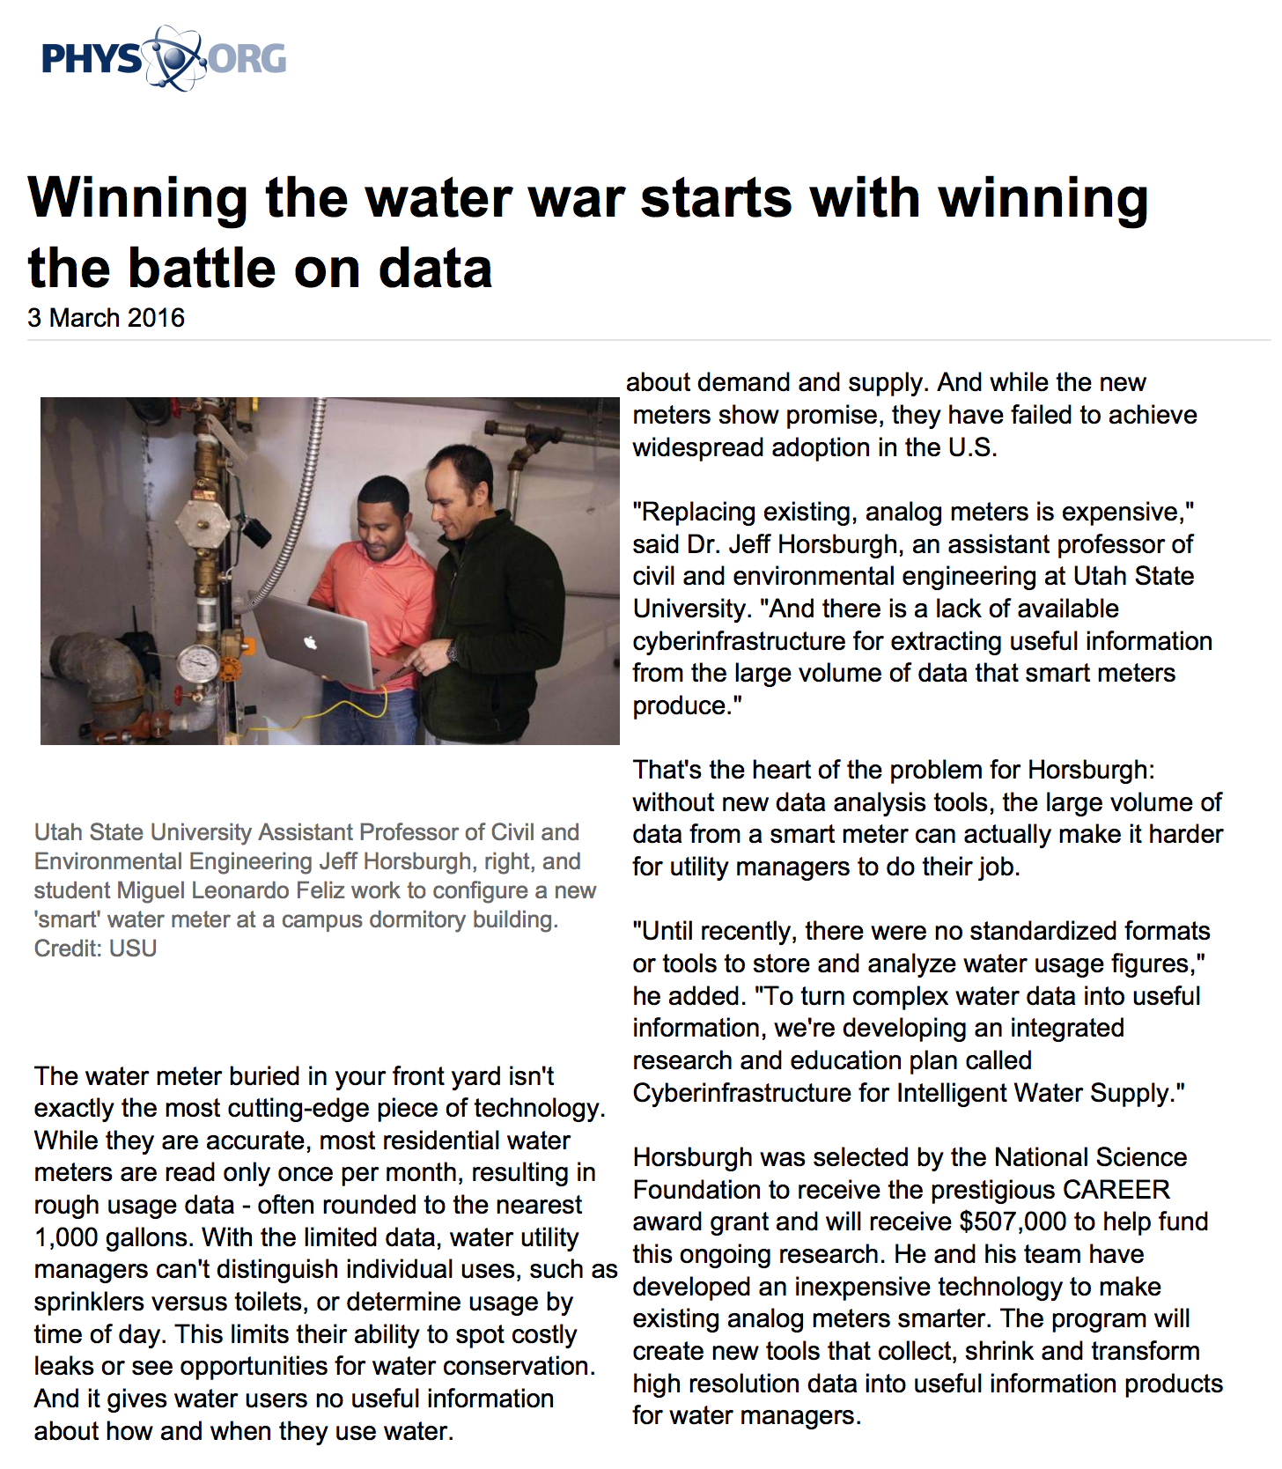
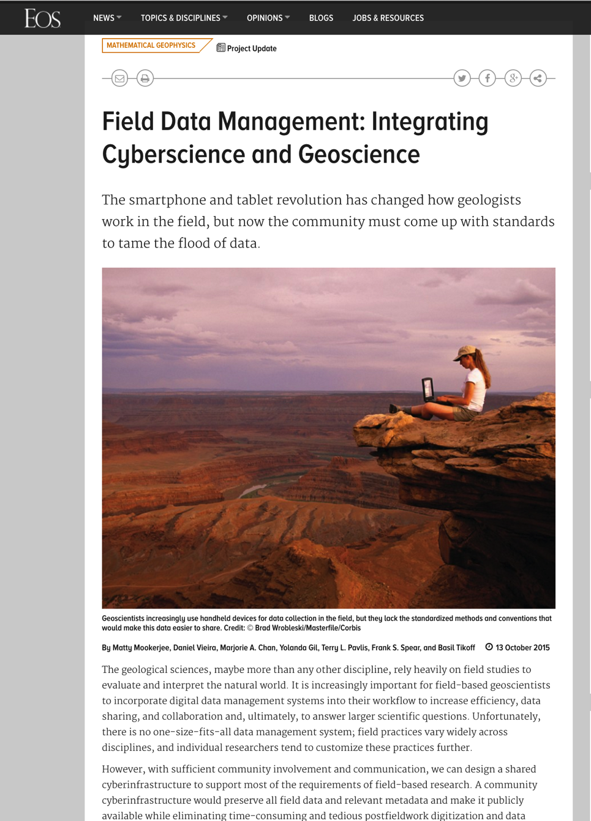
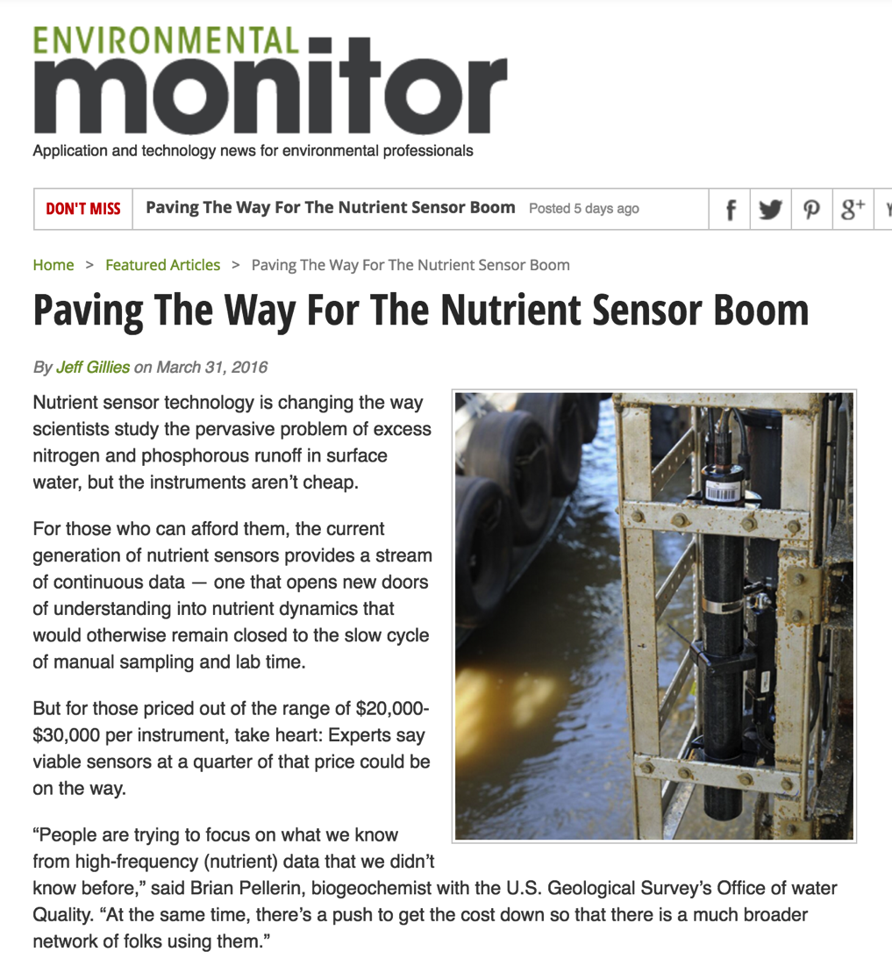
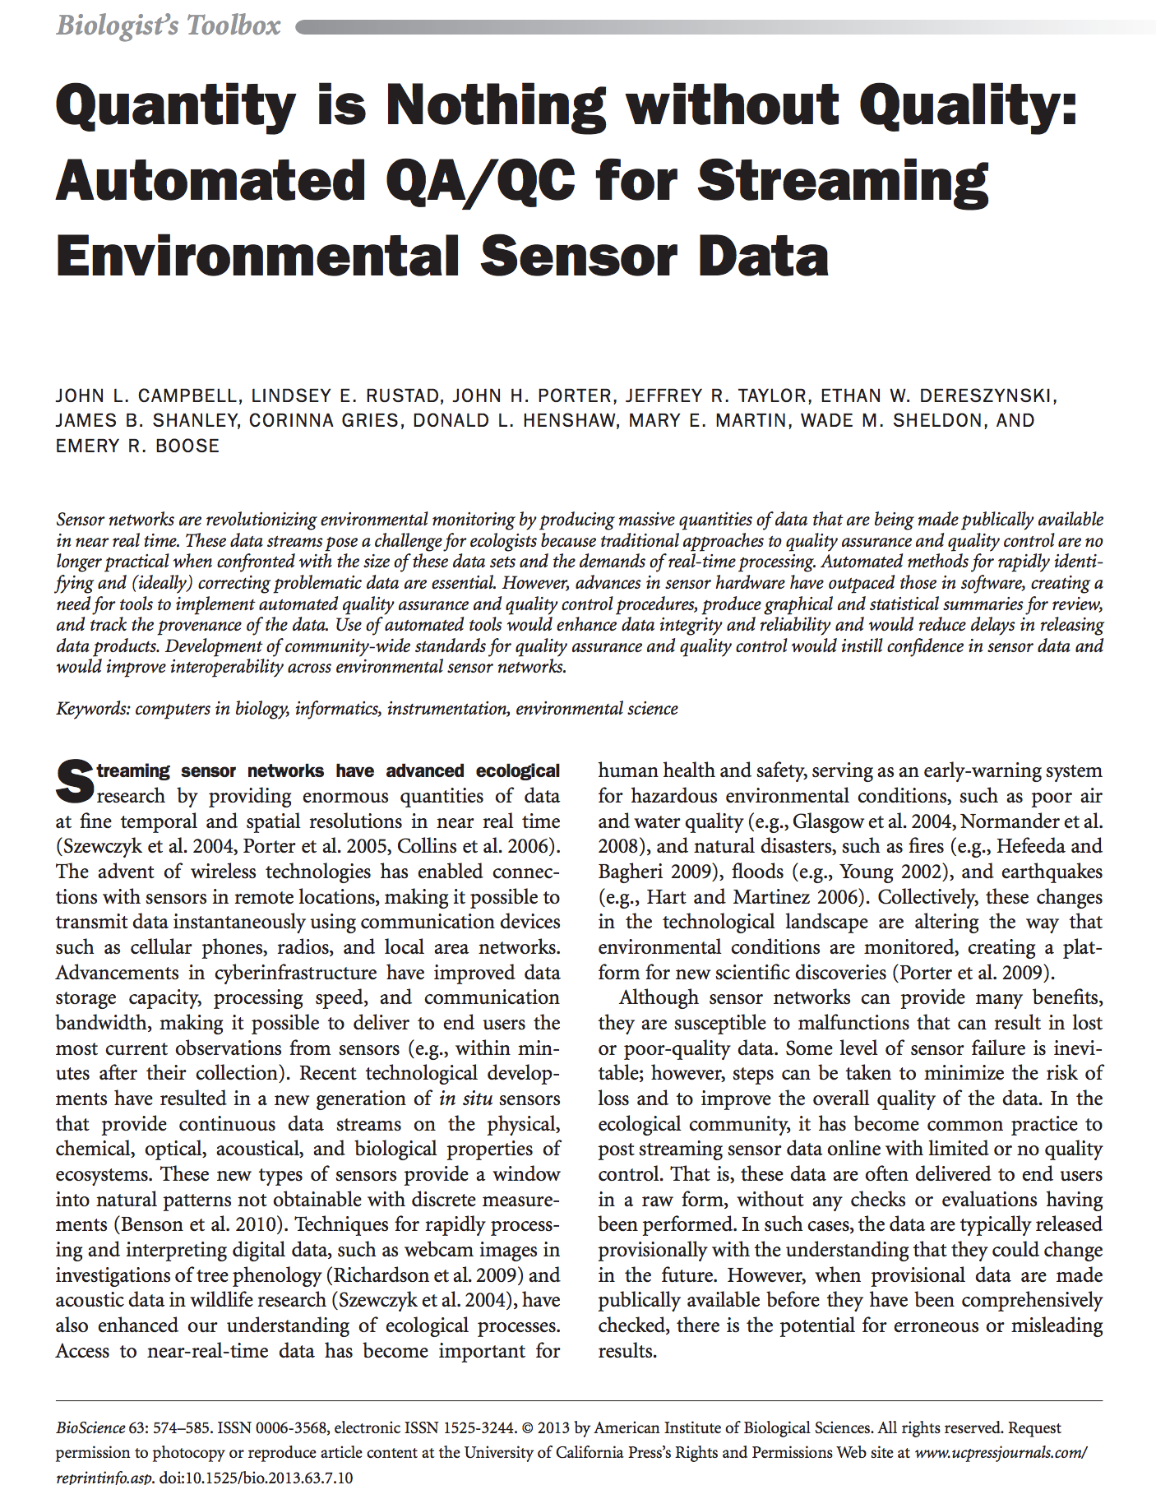
In Situ Environmental Monitoring
Notes:
Hart and Martinez: sensor network revolution
We’re past the revolution and on to the sensor boom- article highlights recent advances in nutrient sensors and the Pellerin etal article in JAWRA
With all this data, Campbell et al tell us that quantity of data is nothing without quality of data
Furthermore, Ffield data management should be considered
And another catchy headline: winning the war on water requires winning the battle on data
Expanding- more sensors as prices drop and technology is more approachable, more sites, longer time periods
So, with that context, I’ll focus on my particular case.

Slide 3
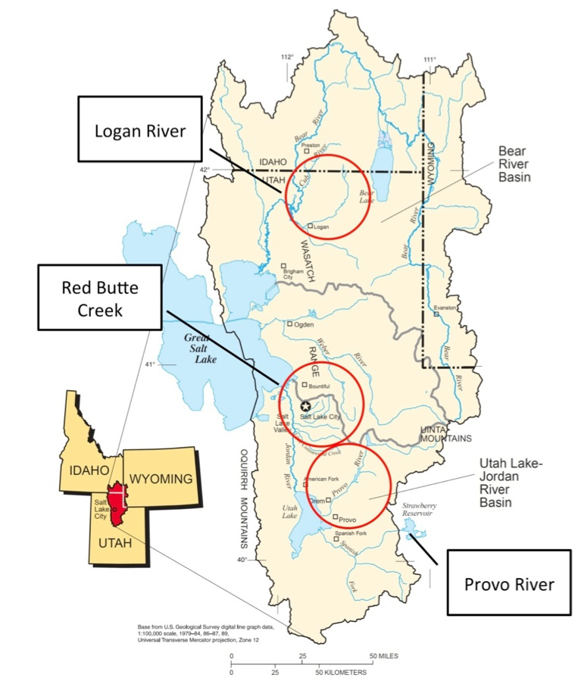
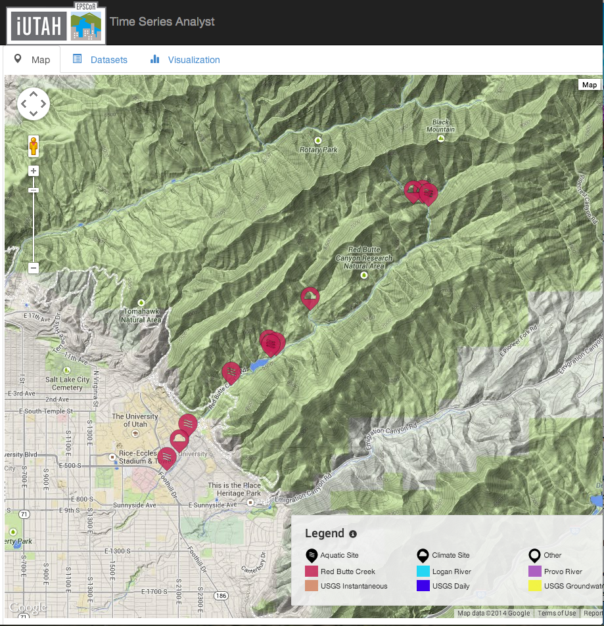
Gradients Along Mountain To Urban Transitions (GAMUT) Network
Ecohydrologic observatory deployed in 3 watersheds in northern Utah, USA: Logan River, Red Butte Creek, Provo River
Watersheds with similar water source (high elevation snow) but different land use transitions
Measures aspects of water inputs and outputs and water quality over mountain-to-urban gradient
Mix of aquatic and terrestrial in situ and re-locatable sensors
Notes:
I’m involved in a collaborative project between universities in Utah called iUTAH, which is focused on hydro-sustainability. A major component is this monitoring network. 3 watersheds instrumented with aquatic, climate, and stormwater sites to observe mountain water transitioning to urban use

Slide 4
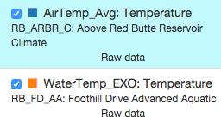
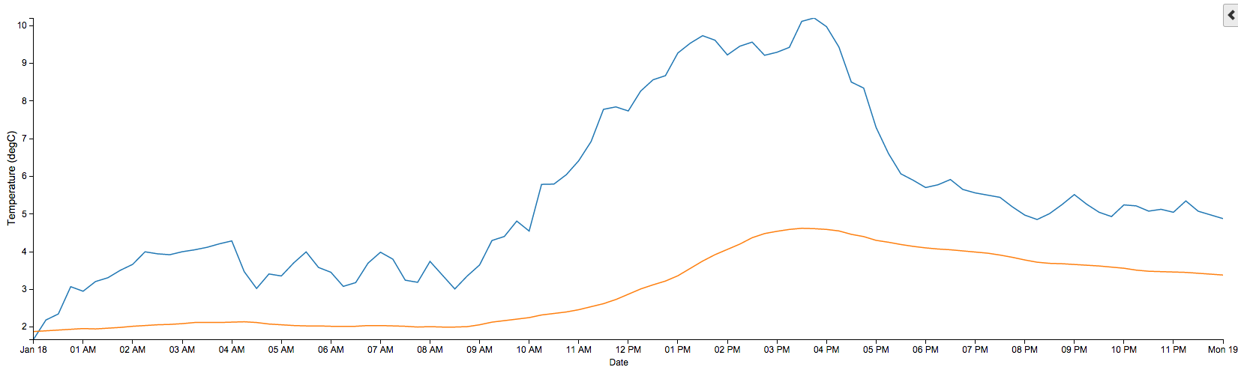
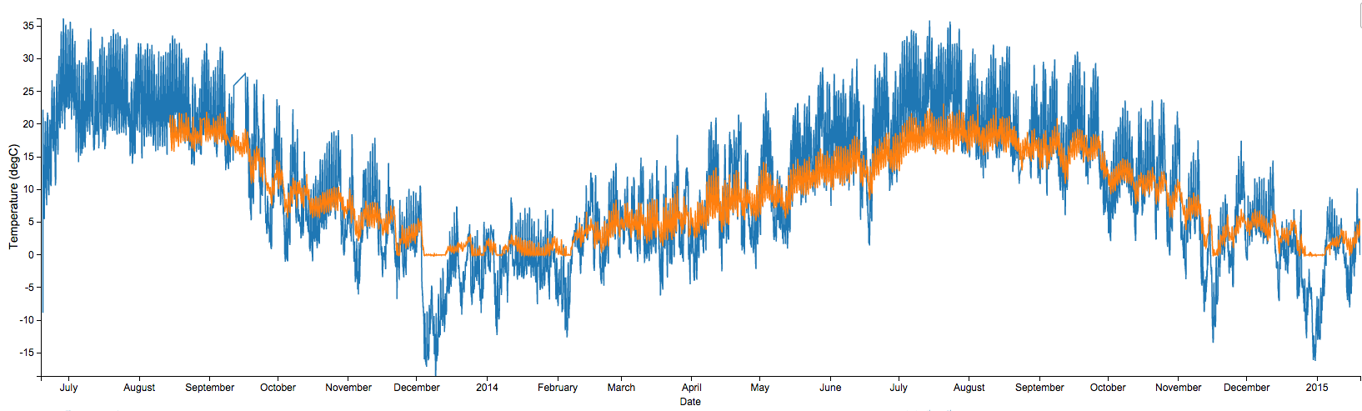
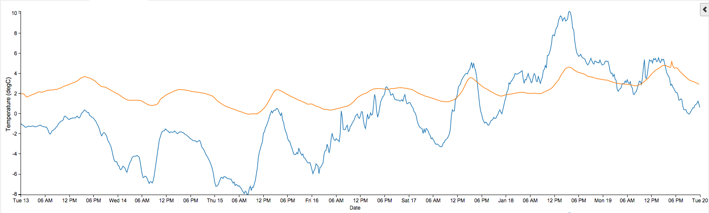
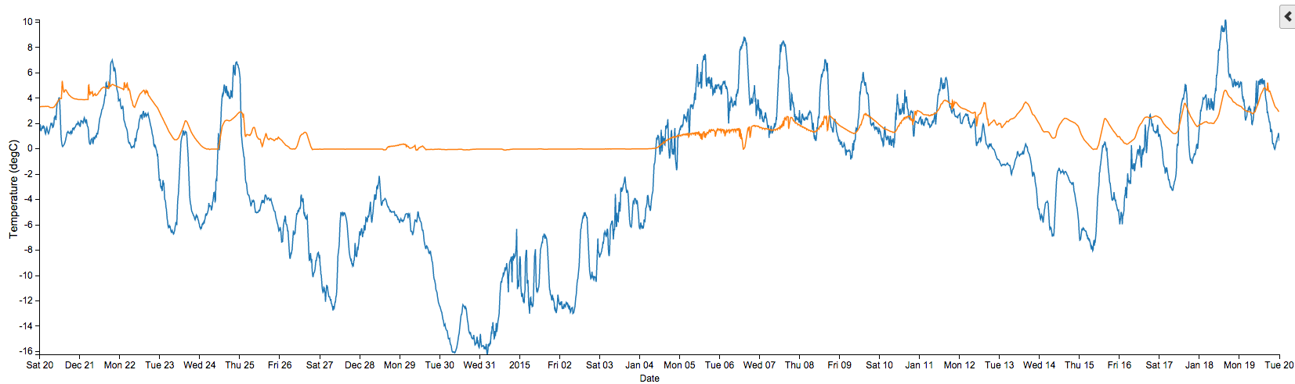
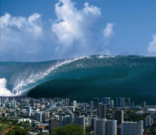
The Data Deluge
One week = 672 observations
One day = 96 observations
One month = 2880 observations
One year = 35,040 observations
So far (~3 years) = 105,000+ observations
Times 14 Aquatic Sites with ~26 Variables
Times 14 Climate Sites with ~74 Variables
Plus different versions of the data (raw versus checked) = over 200 million observations
You need some infrastructure to manage and share the data.
Notes:
So, let’s talk about the volume of data being generated in the network.
- it is desirable to automate as much of the data management workflow as possible
- effective cyberinfrastructure is necessary to make data products available and usable

Slide 5
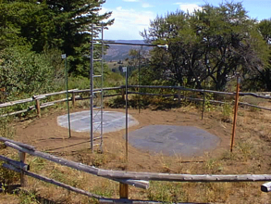
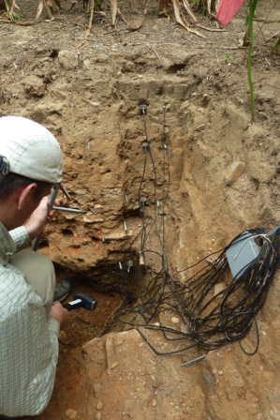
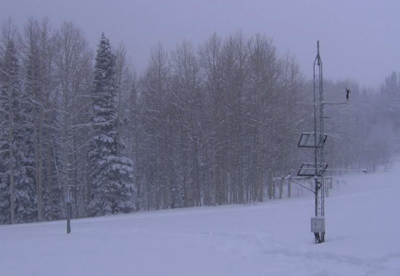
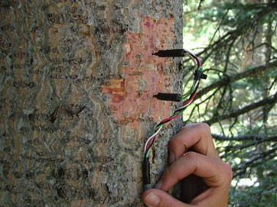
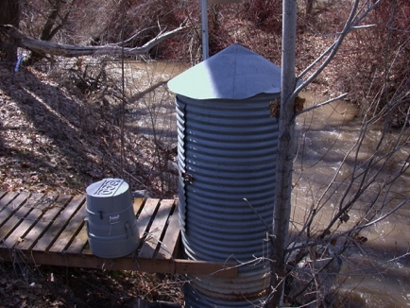
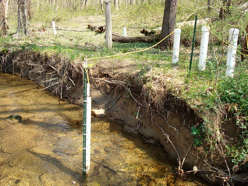
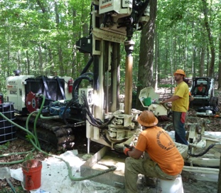
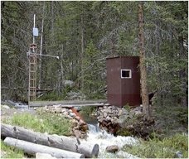
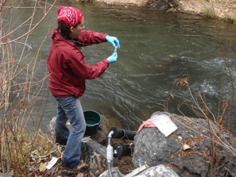
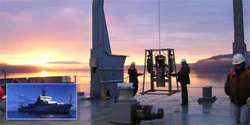
Challenges to Managing Sensor Data
Rain, Snow, and Climate
Soil water and chemistry
Volume of data
Data heterogeneity
Multiple watersheds
Multiple institutions
Multiple personnel
Scale
Data quality assurance and quality control
Standardize data editing
Synchronize timing, data access, equipment tracking
Sapflux
Water quality
Water quantity
Groundwater
Mobile Platforms
Notes:
In addition to the quantity of data, we are dealing with different types of data that need complete metadata descriptions.
Researchers and practitioners need tools for data import and storage as well as data access and management.
In addition to addressing the challenges presented by the sheer quantity of data, monitoring networks need practices to ensure high data quality, including procedures and tools for post processing.
Data quality is further enhanced if networks are able to track physical infrastructure such as equipment, deployments, calibrations, and other events related to site maintenance and associate these details with observational data.

Slide 6
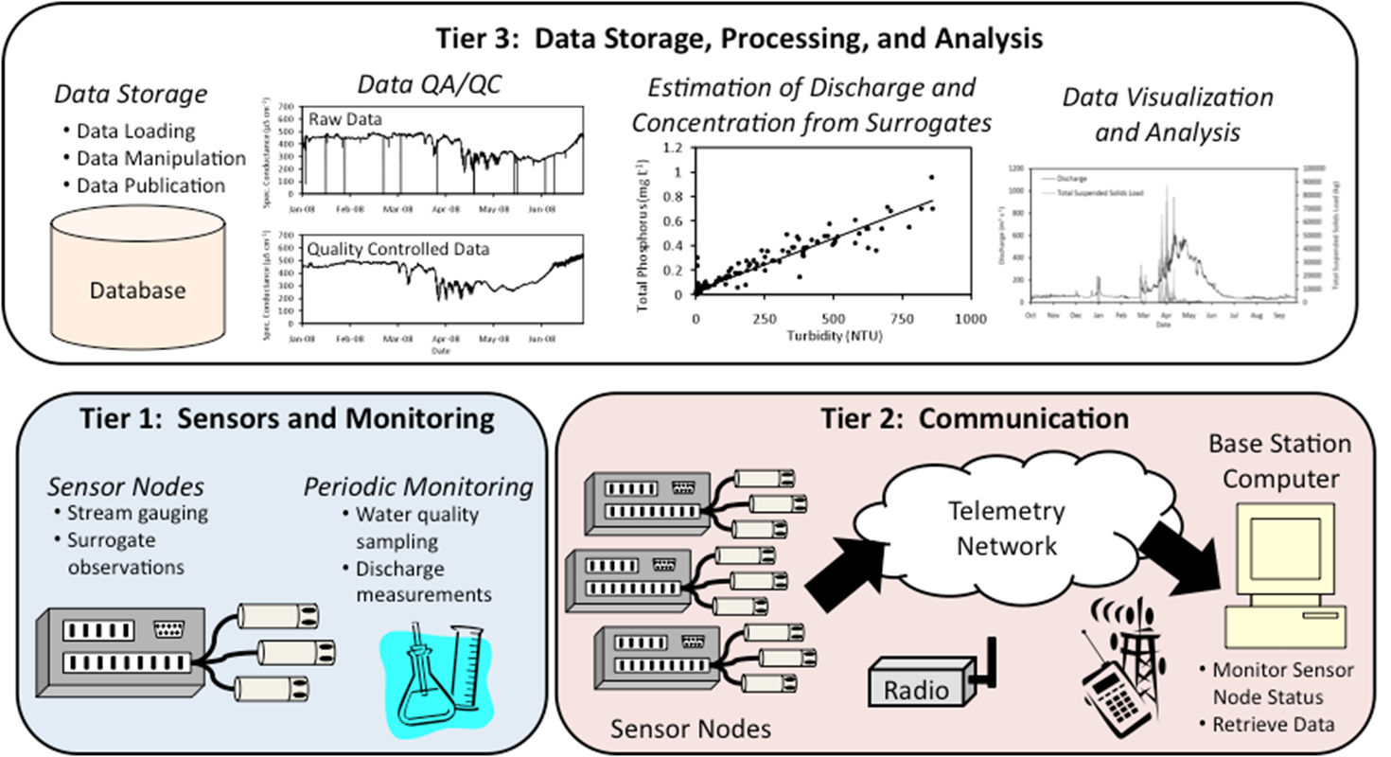
Cyberinfrastructure
Horsburgh, J. S., A. Spackman Jones, D. G. Tarboton, D. K. Stevens, and N. O. Mesner (2010), A sensor network for high frequency estimation of water quality constituent fluxes using surrogates, Environmental Modelling & Software, 25, 1031-1044, doi:10.1016/j.envsoft.2009.10.012.
Notes:
Cyberinfrastructure is a layer in sensor network design to account for data storage, processing, and analysis steps.

Slide 7
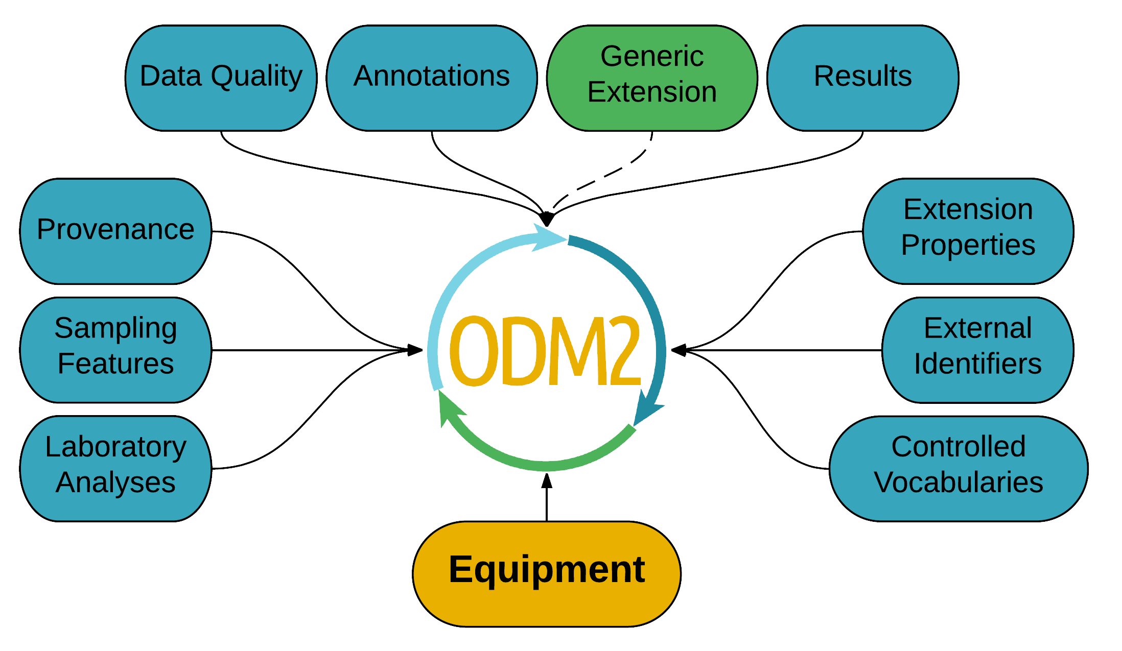
ODM2: Observation Data Model v. 2
Notes:
We’re working to develop our tools to be compatible with the structure of Observations Data Model 2 (ODM2).
What is ODM2?
a community-developed information model for spatially discrete, feature based earth observations
You may have heard of or used the original ODM- developed in conjunction with CUAHSI. Many users found ODM1 to be slightly inadequate- it didn’t handld discrete, sample-based data as well, didn’t handle equipment.
ODM2 designed to be much broader, also designed to be extensible and flexible
Made up of entities that help define and describe observations that are made.
Actions: Performed by people on sampling features and may have a result of a particular variable

Slide 8
GAMUT Data Workflow
Notes:
We have developed several open-source software tools to contribute to a data management workflow for streaming sensor data including data loading, visualization, post-processing, and equipment management.
This figure show the overall data workflow that we’ve designed and deployed
Management of the GAMUT data is centralized where the data from all of the remote sites are aggregated, loaded into operational databases, and shared on the Internet via a suite of web applications. Each of the components is described in more detail.

Slide 9
Sensor Data Acquisition
Notes:
Regularly acquire data from remote field sites to a centralized base station.

Slide 10
Data Loading and Storage
Notes:
Data within the text files loaded into operational databases using the Streaming Data Loader.

Slide 11

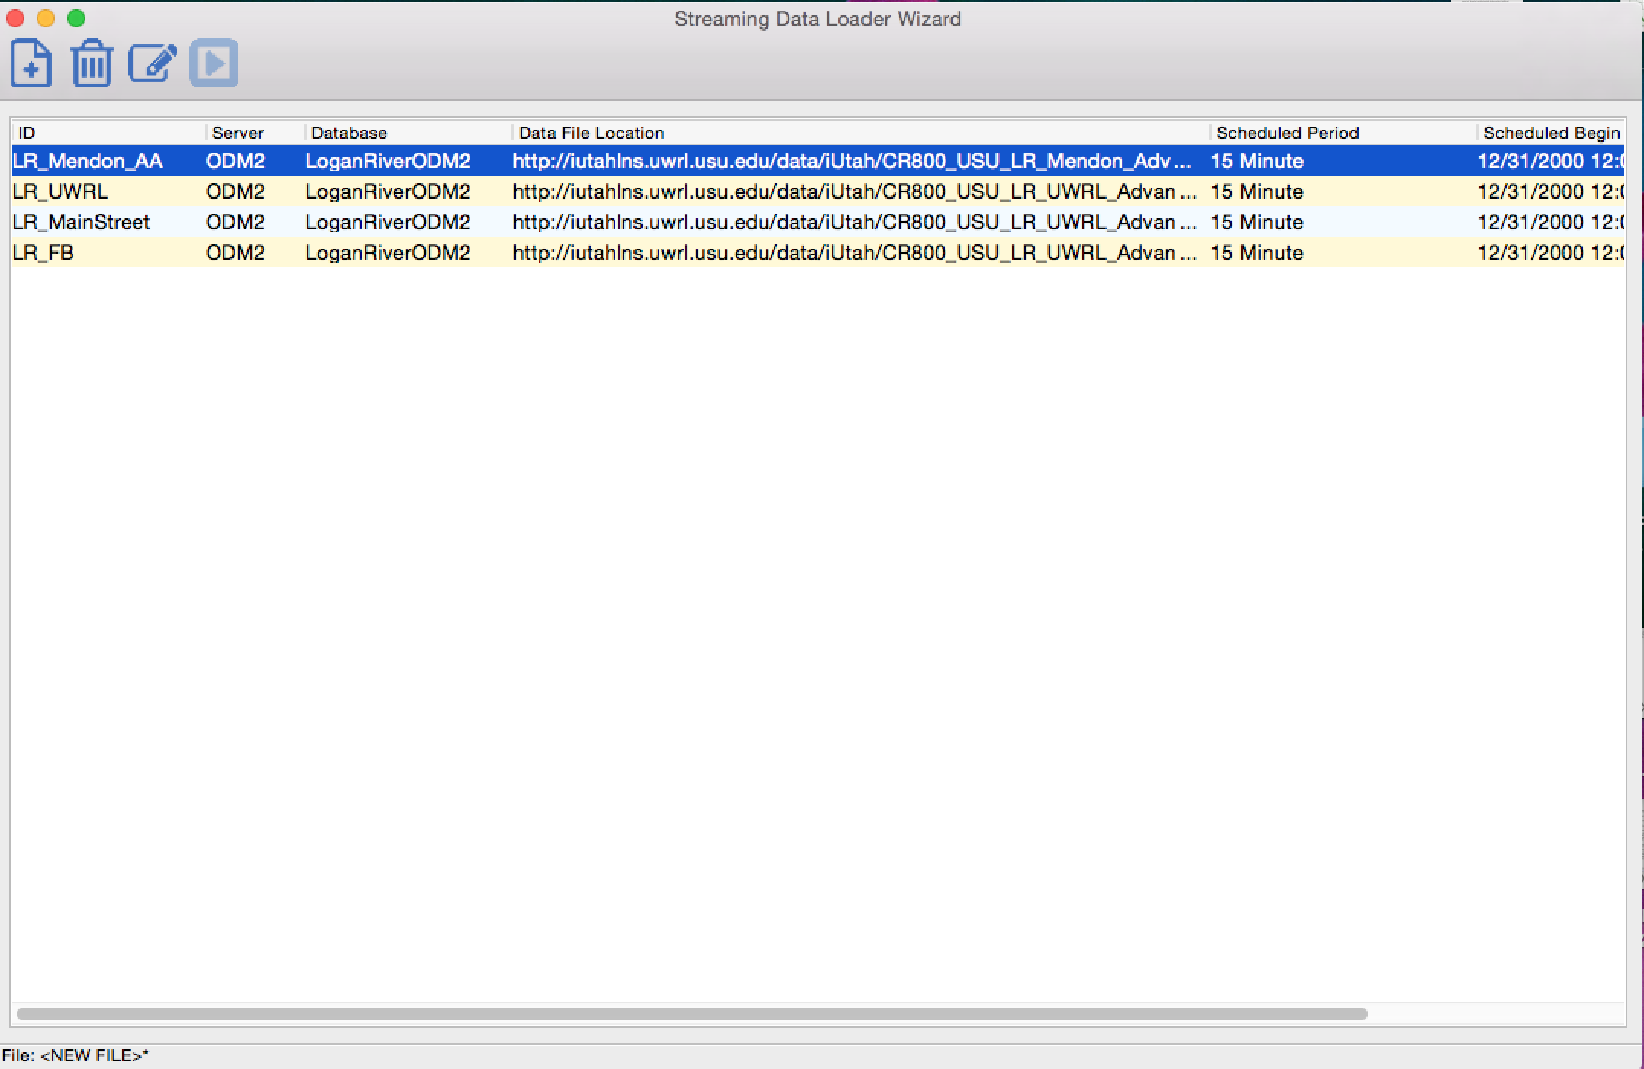
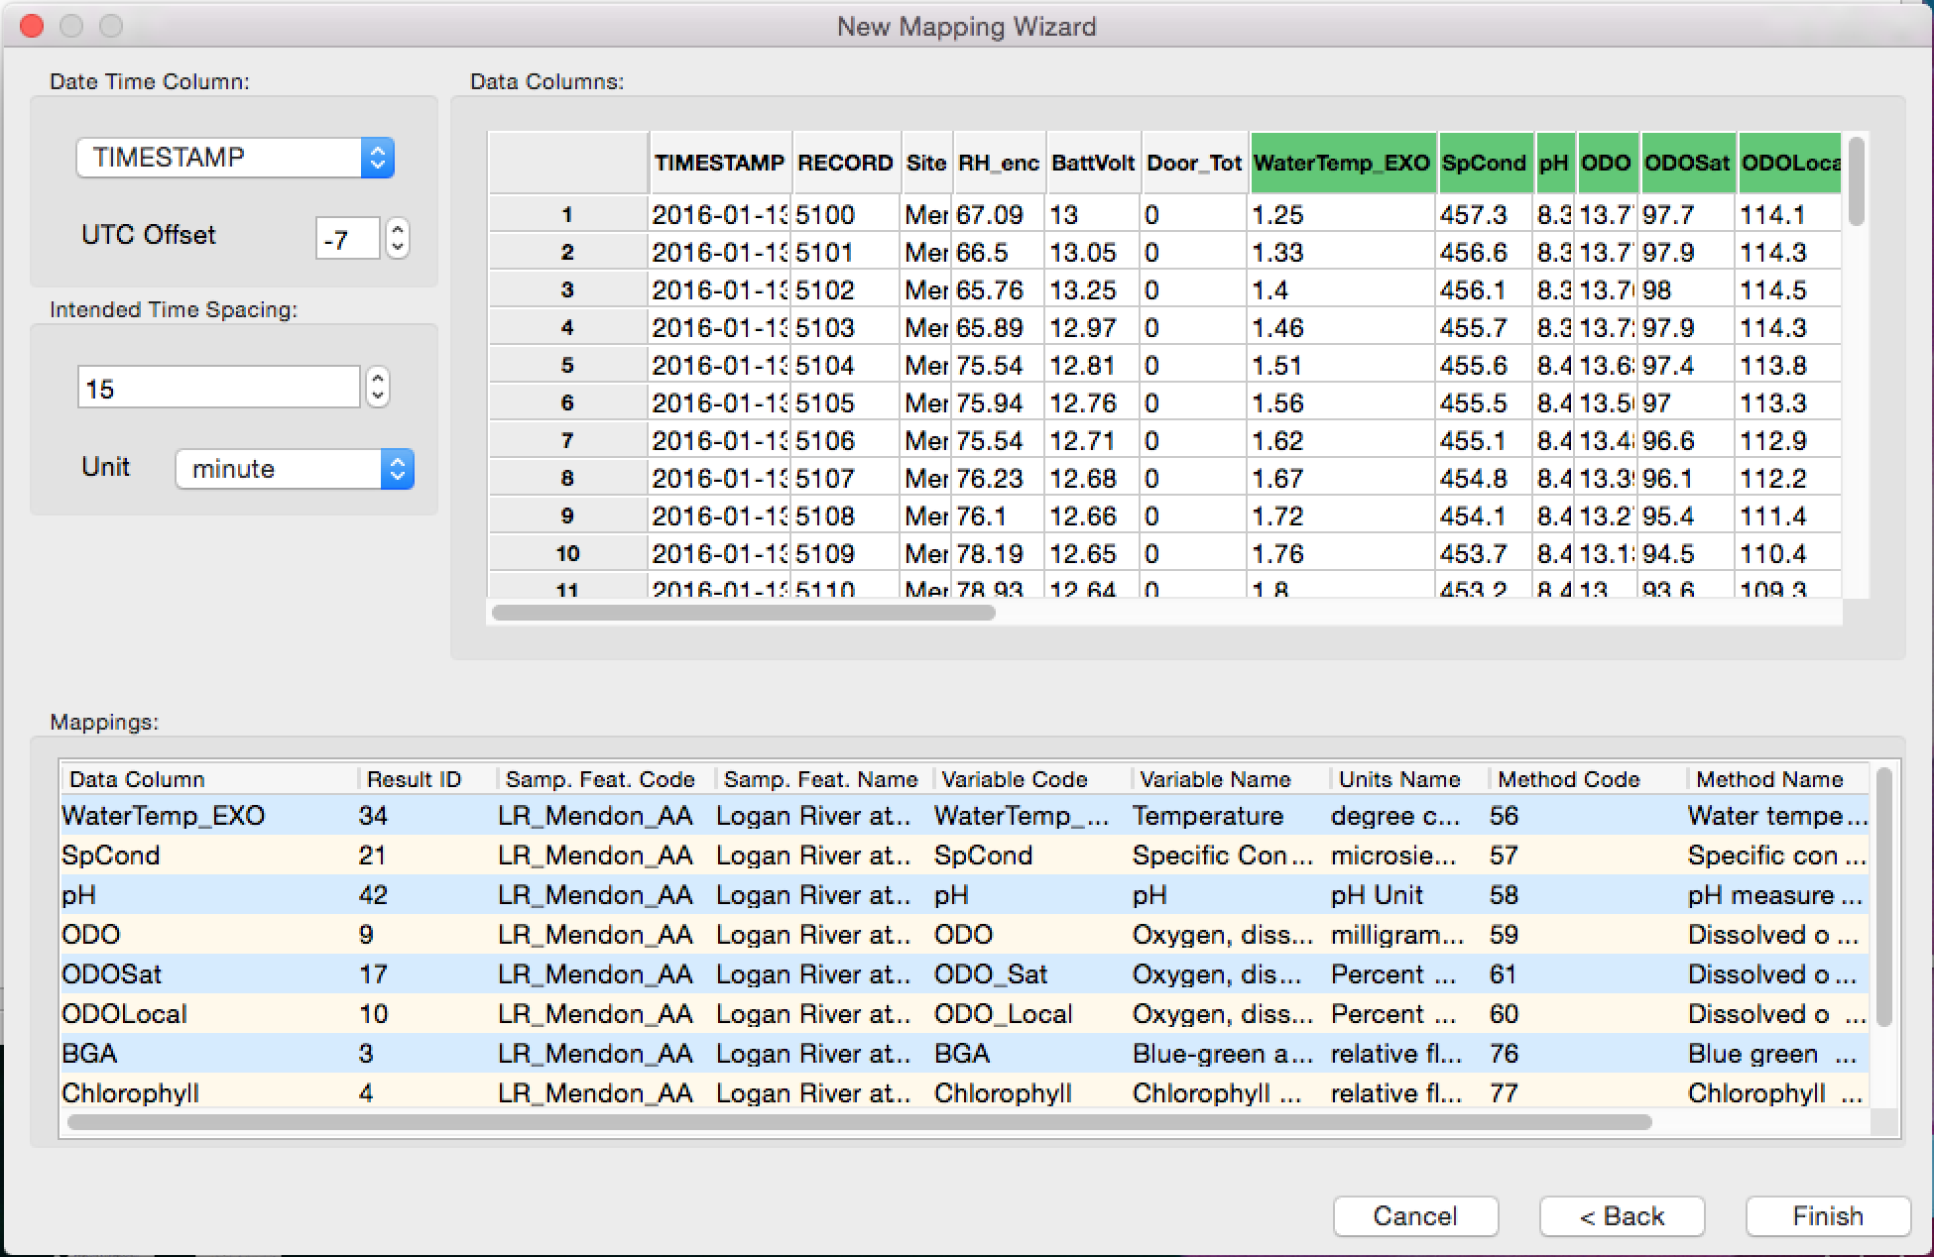
Data Loading and Storage
Notes:
Streaming Data Loader: is a Python-based software application that we have developed to map text-based files from a sensor or datalogger for insertion into an ODM2 database- mapping means that the appropriate metadata is assigned- site, variable, etc..
Once the files are mapped, it is configured to run on a regular schedule so that data loading is automated. It can also be run manually if files are not acquired automatically (i.e., sneaker net)
Features and options include:
Cross-platform and compatible with different database types
Can do bulk or incremental loads

Slide 12
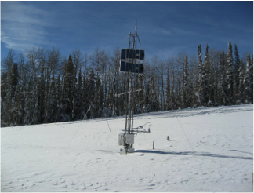
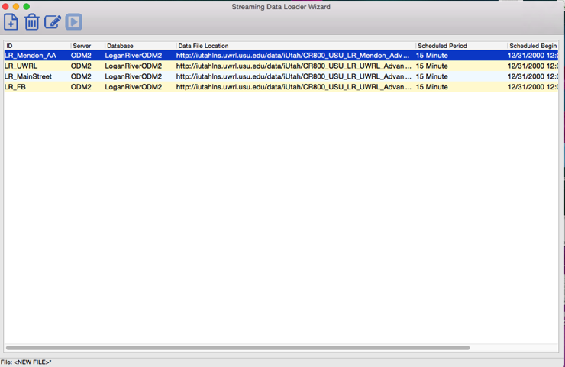
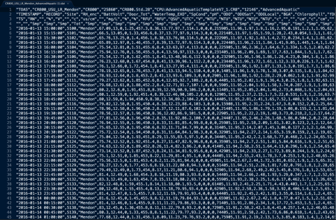


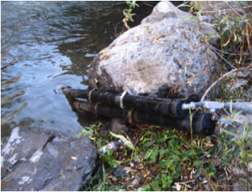



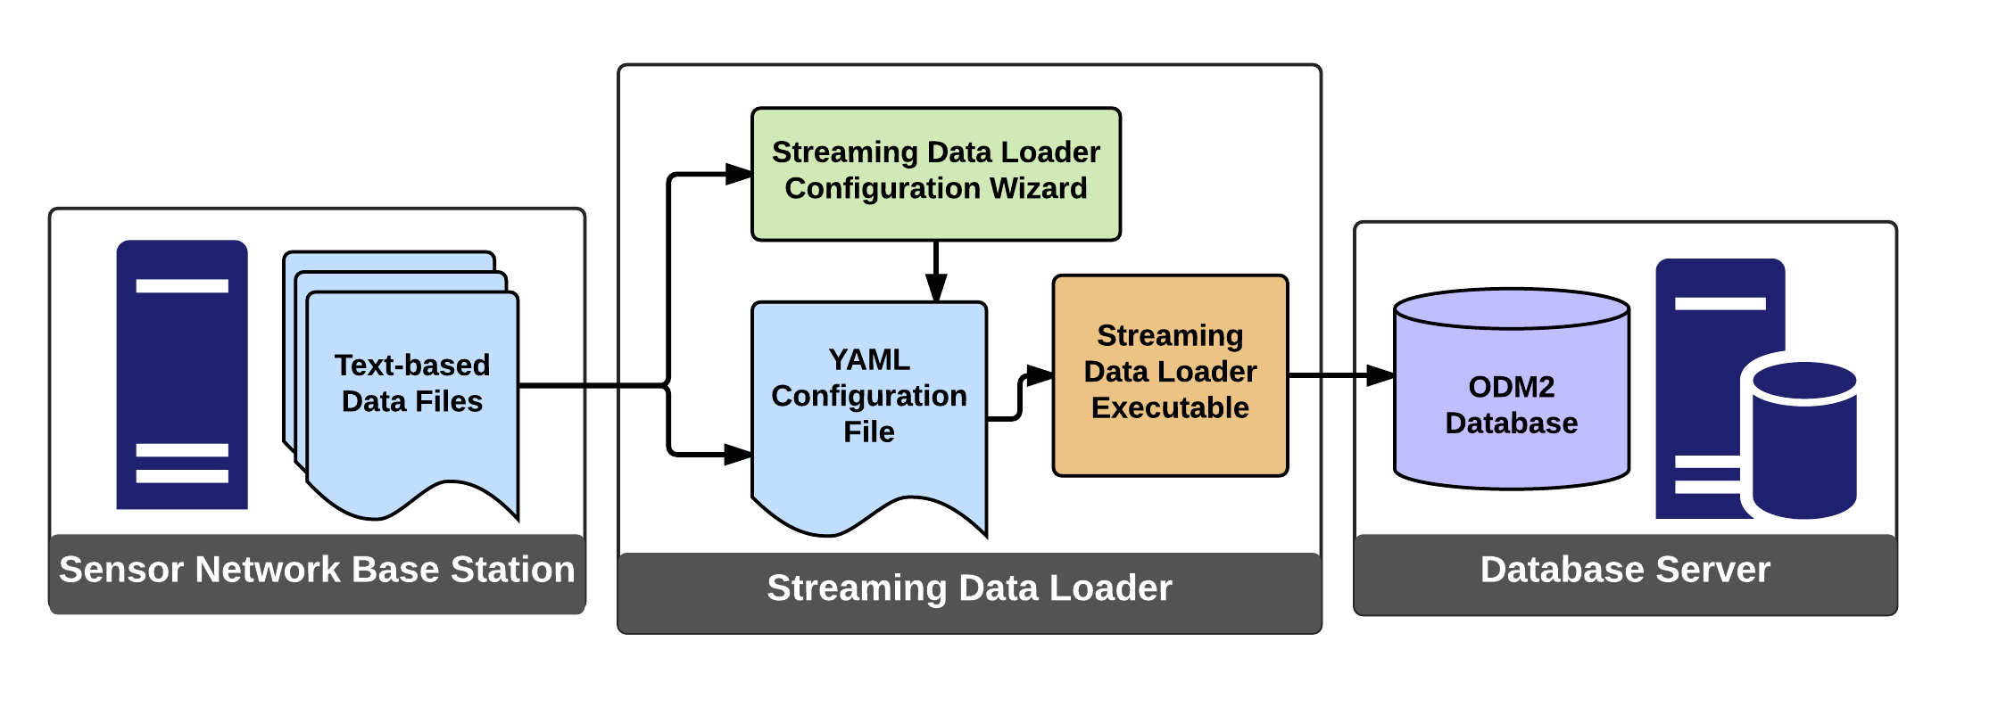
Data Loading and Storage
ODM2
Notes:
Field data come into tables, which are mapped by the streaming data loader to associate metadata and when it runs, data are loaded to an ODM2 database
Same workflow with a diagram. Data files on a base station, mapped by the streaming data loader, loads the data to a database server.
Streaming data loader has a wizard that helps with the mapping, and after the files are mapped and that configuration stored, the executable gets the job done.

Slide 13
Web-Based Data Access
Notes:
resources for data dissemination and visualization.
We have various mechanisms for data dissemination
In particular, we developed a web-based time-series visualization tool

Slide 14
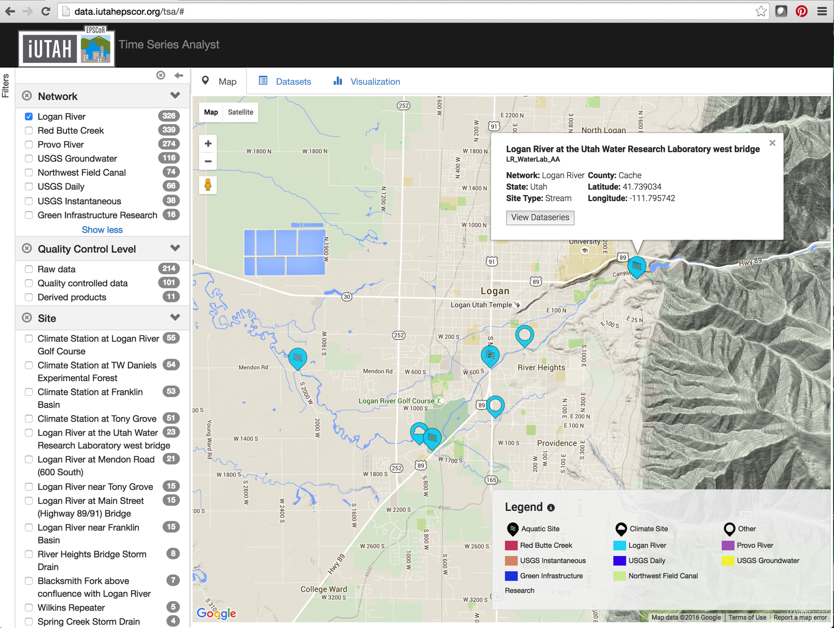
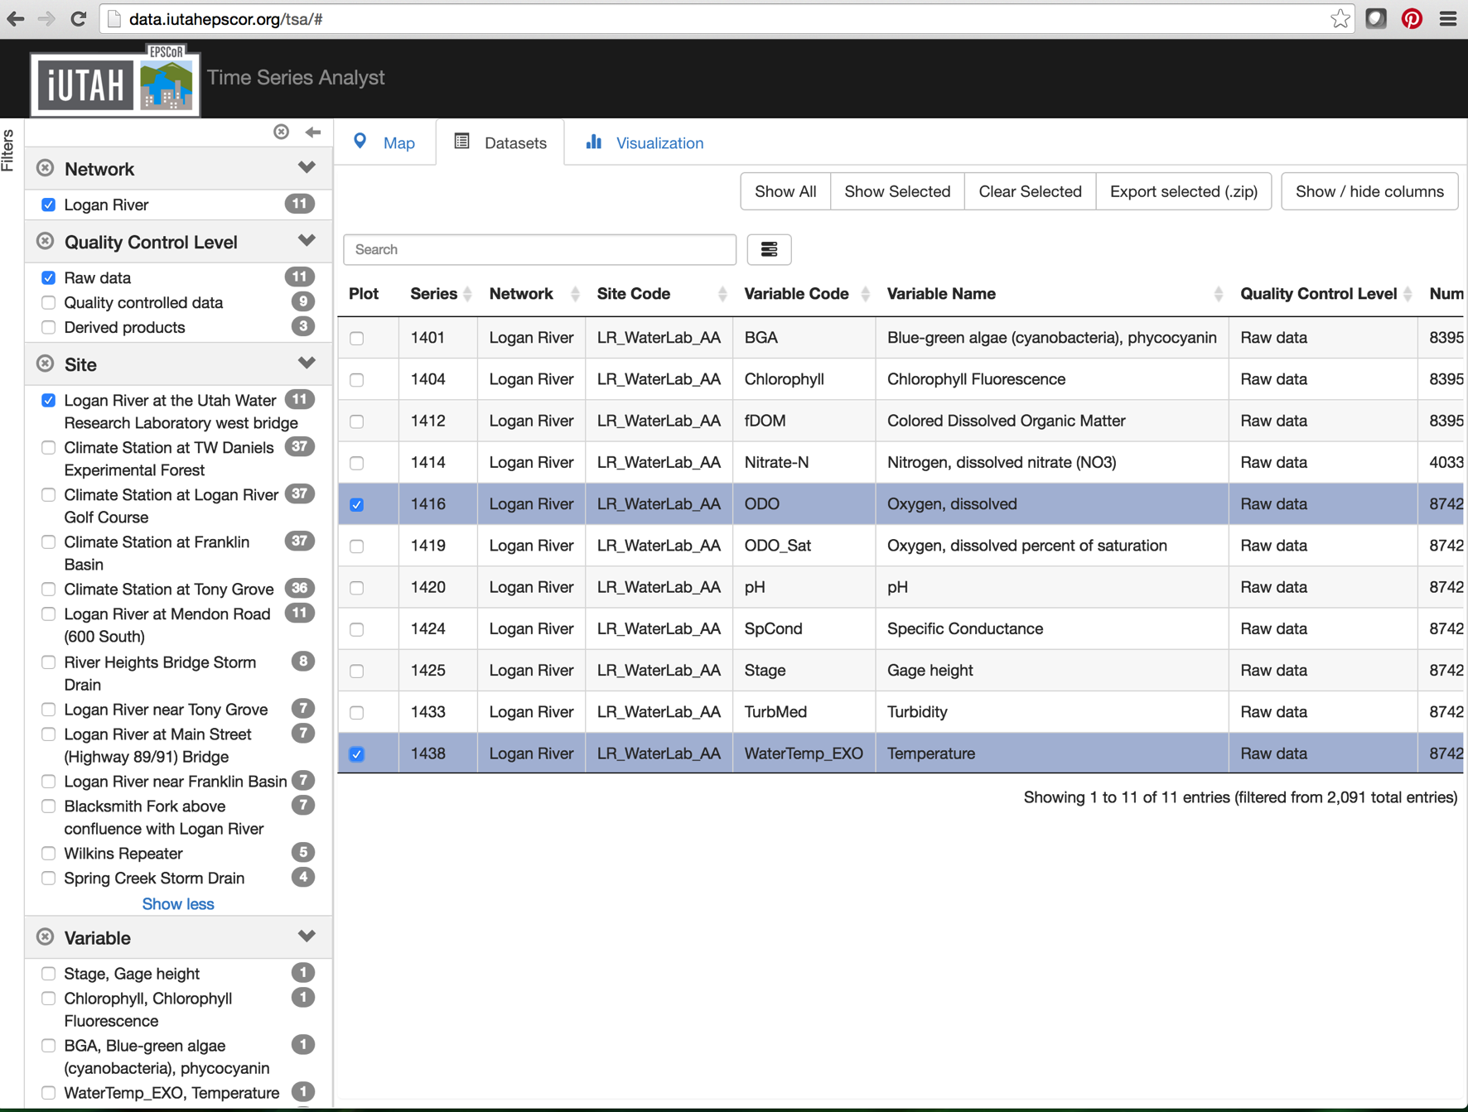
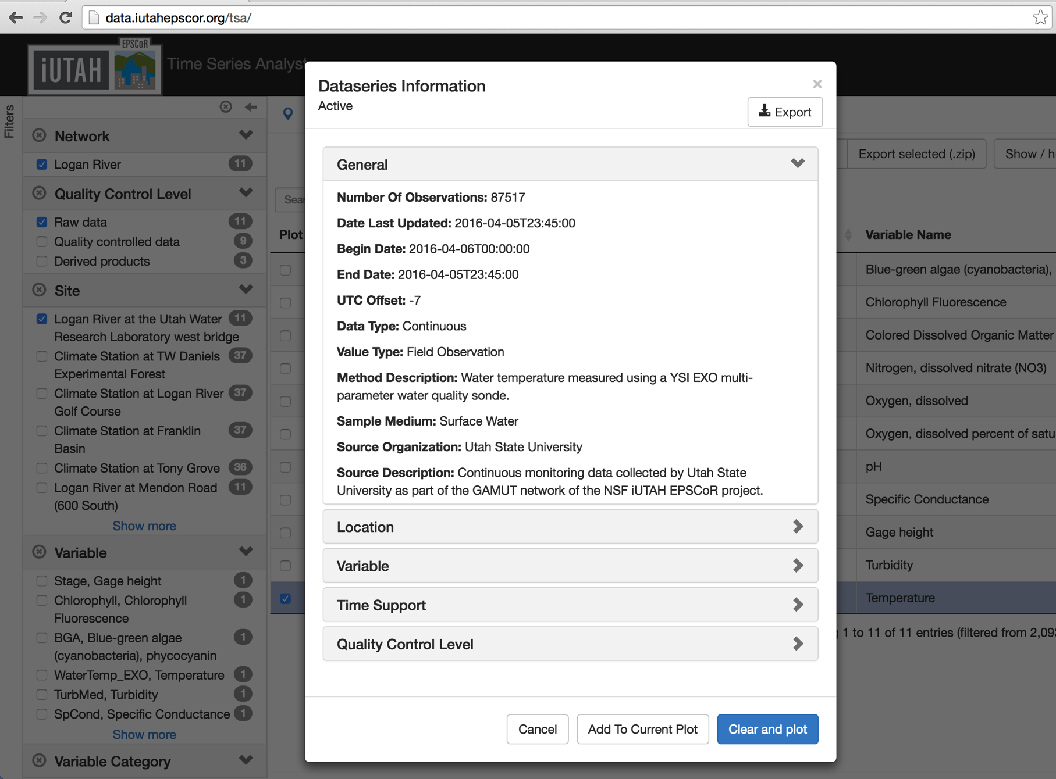
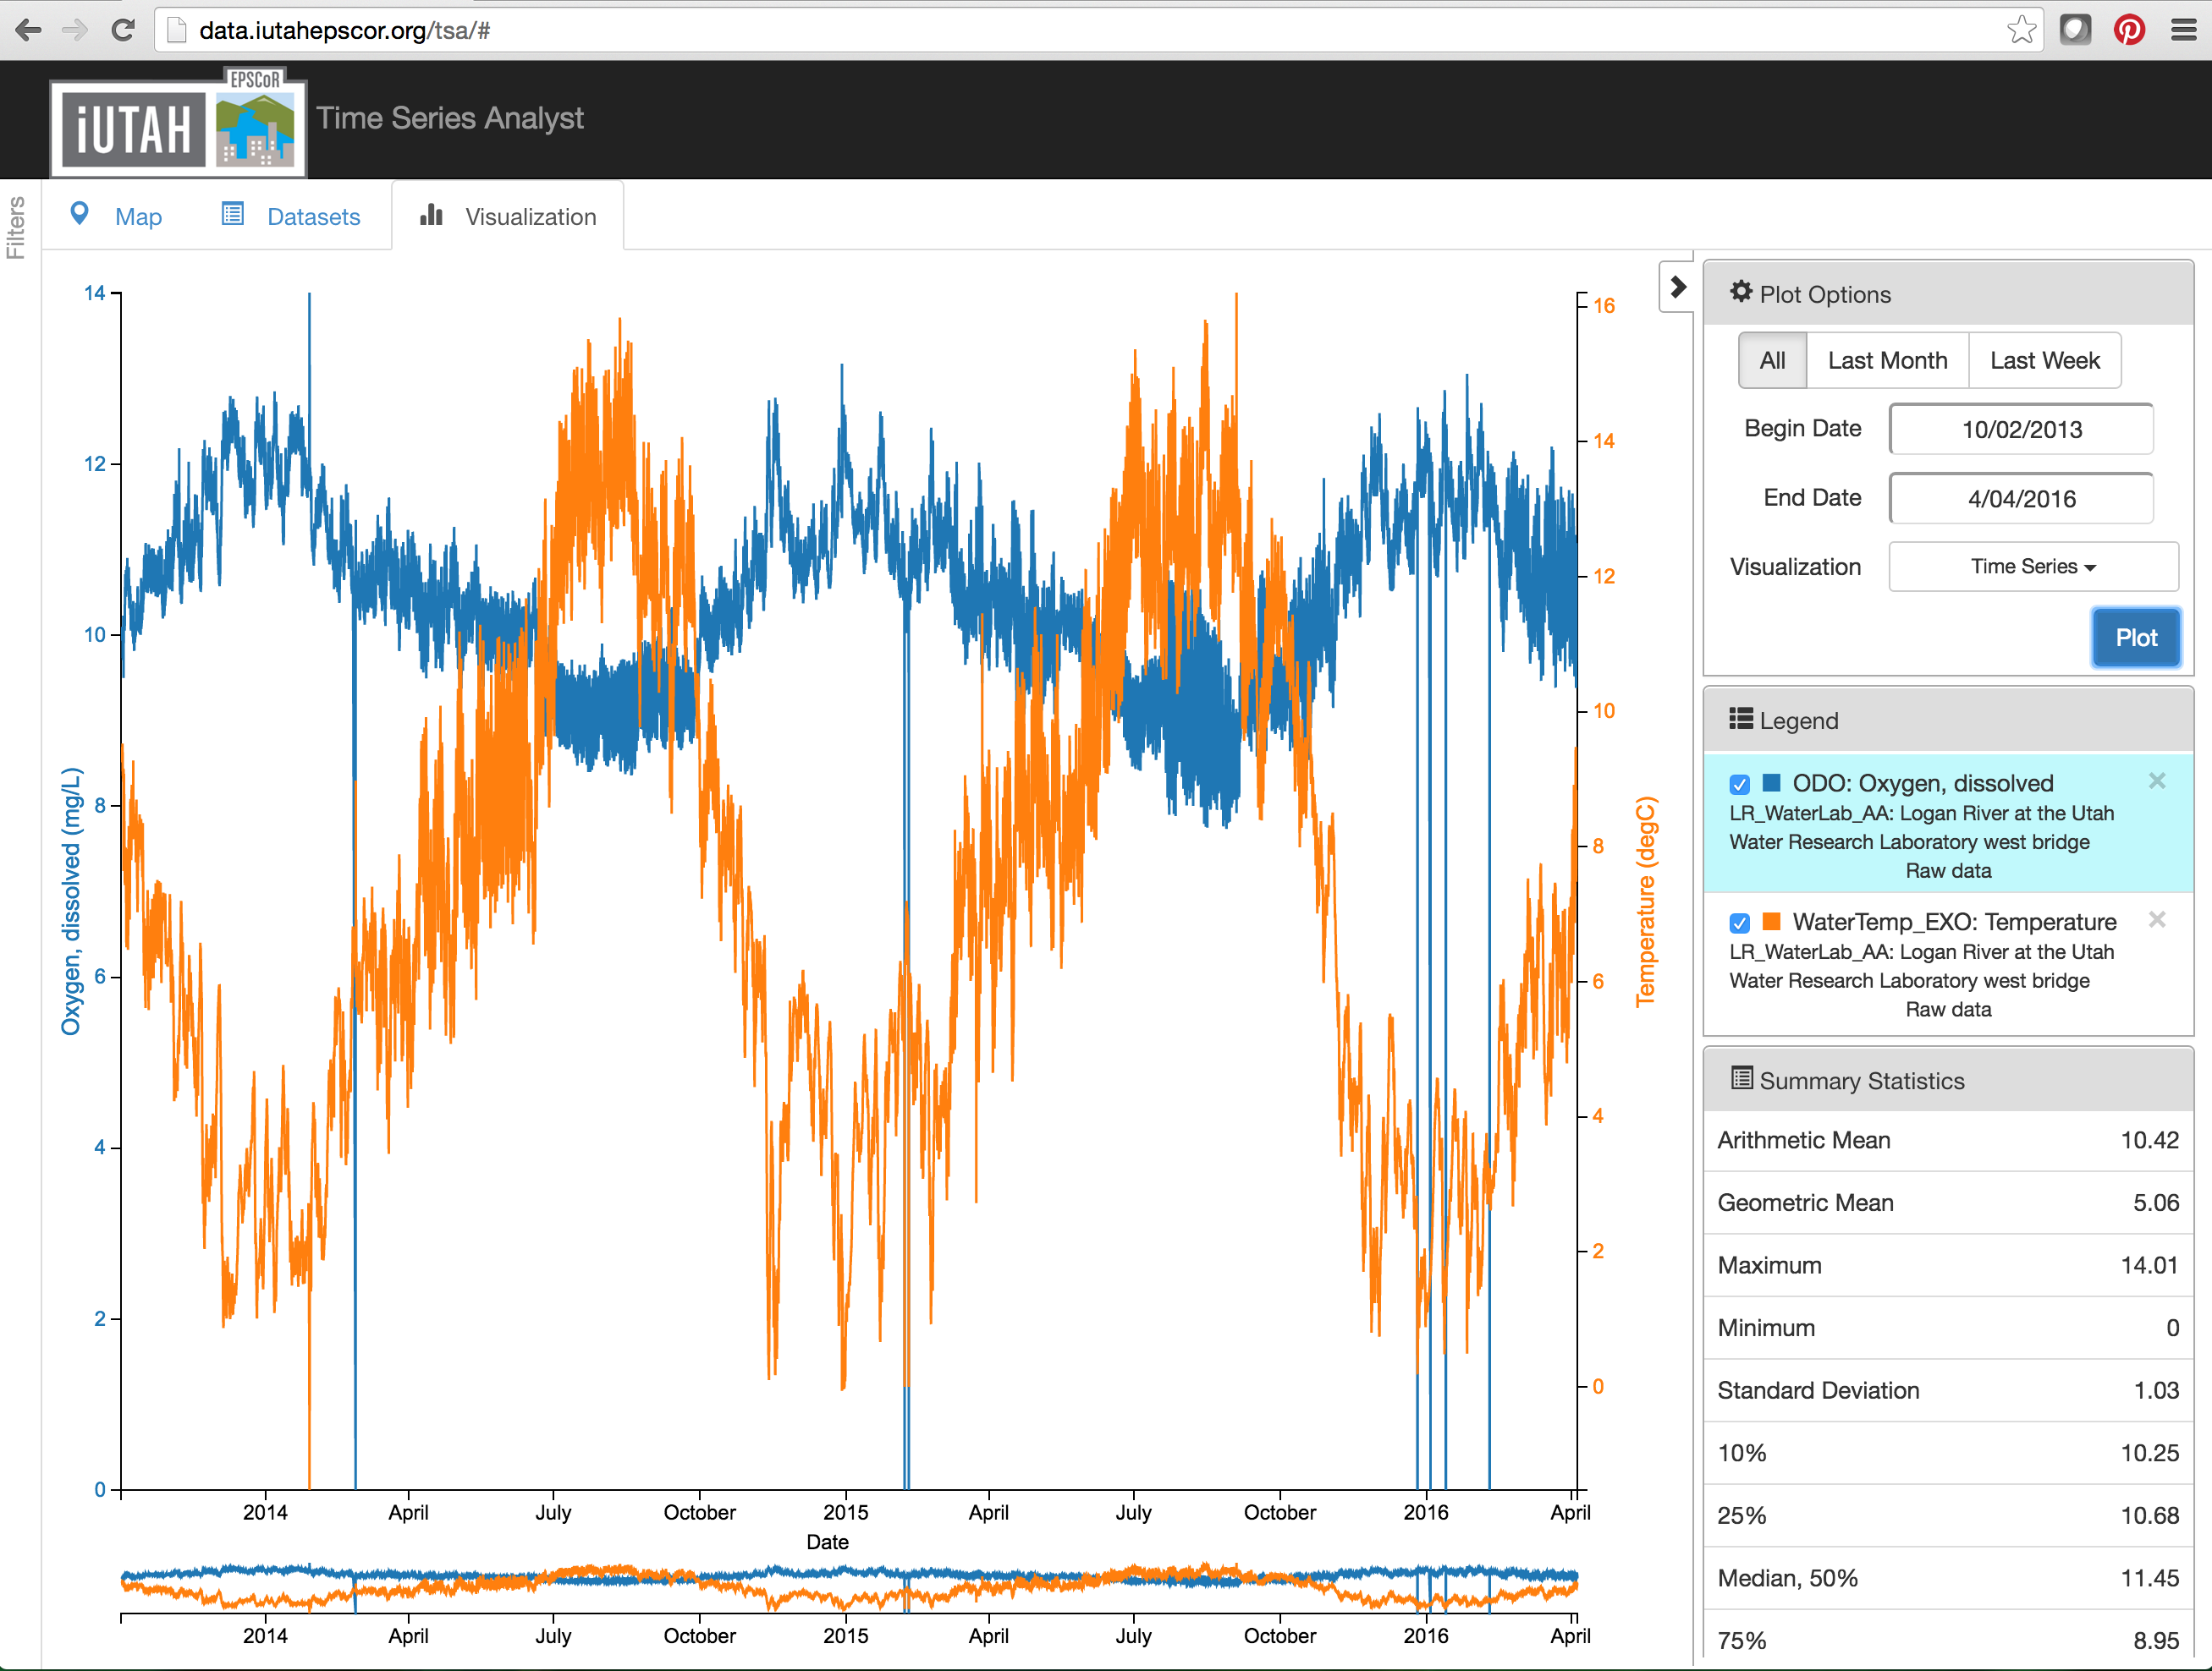
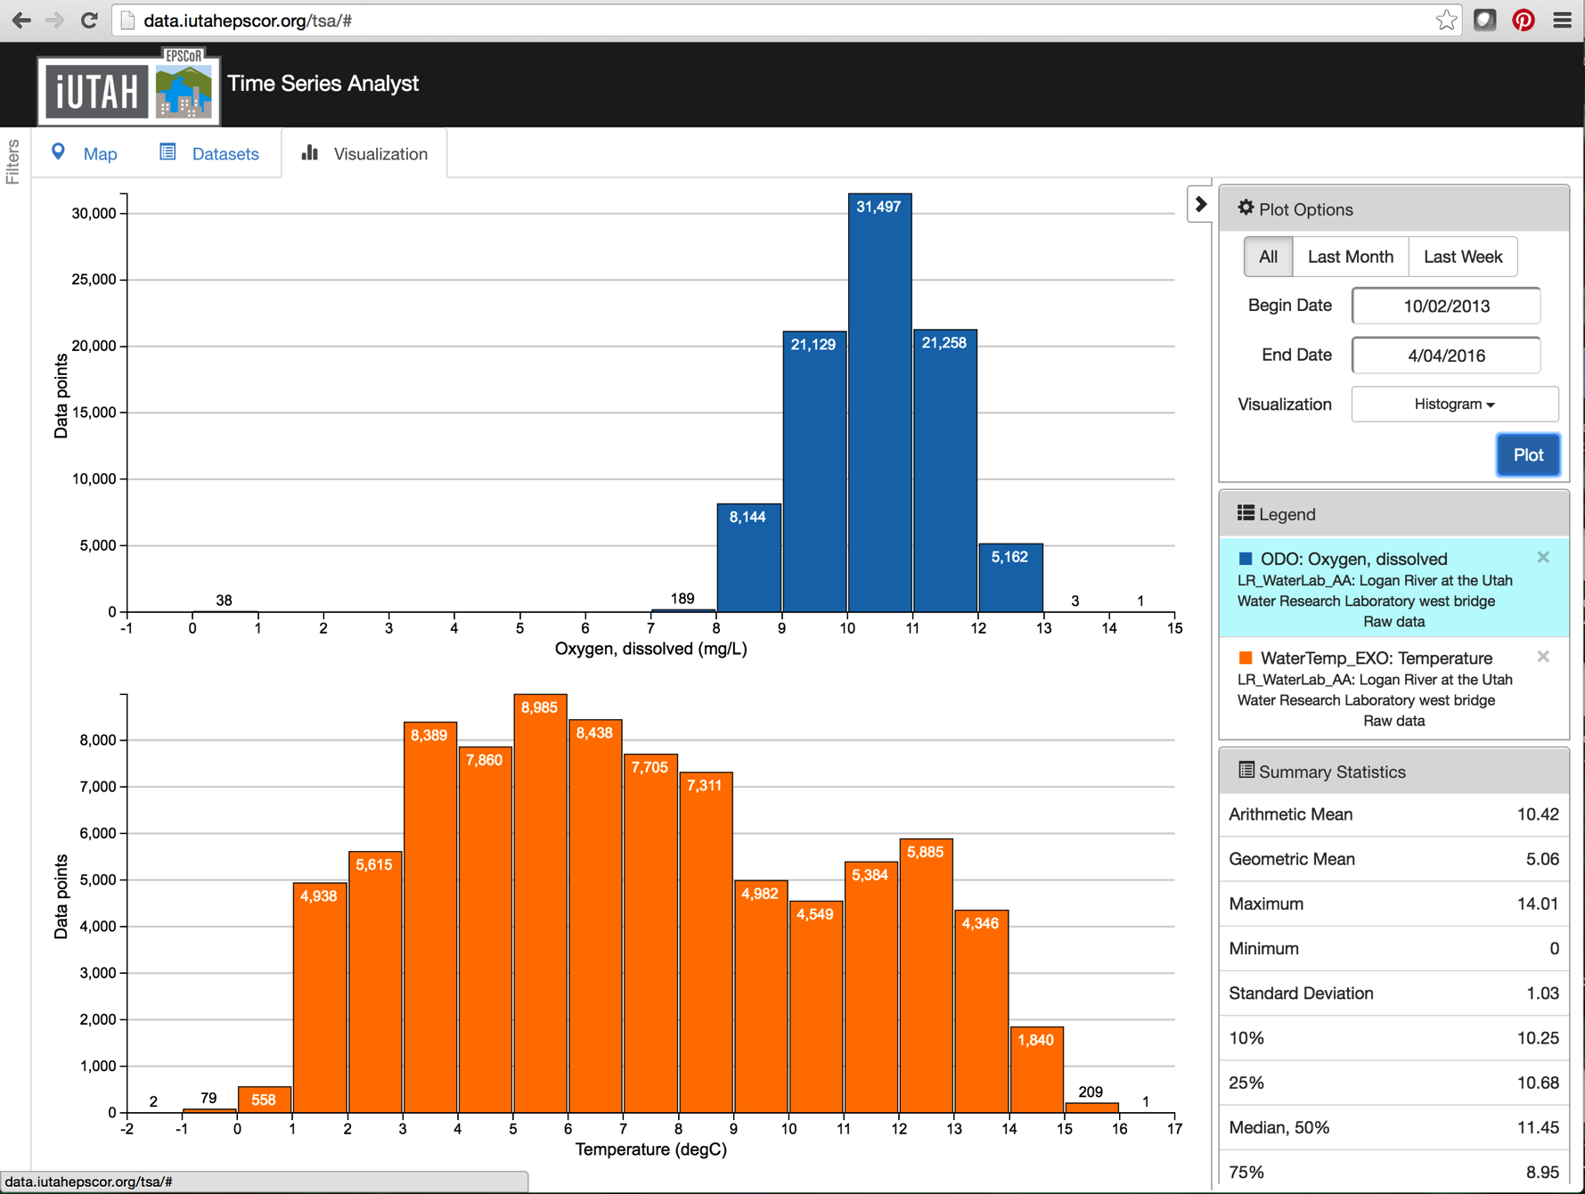
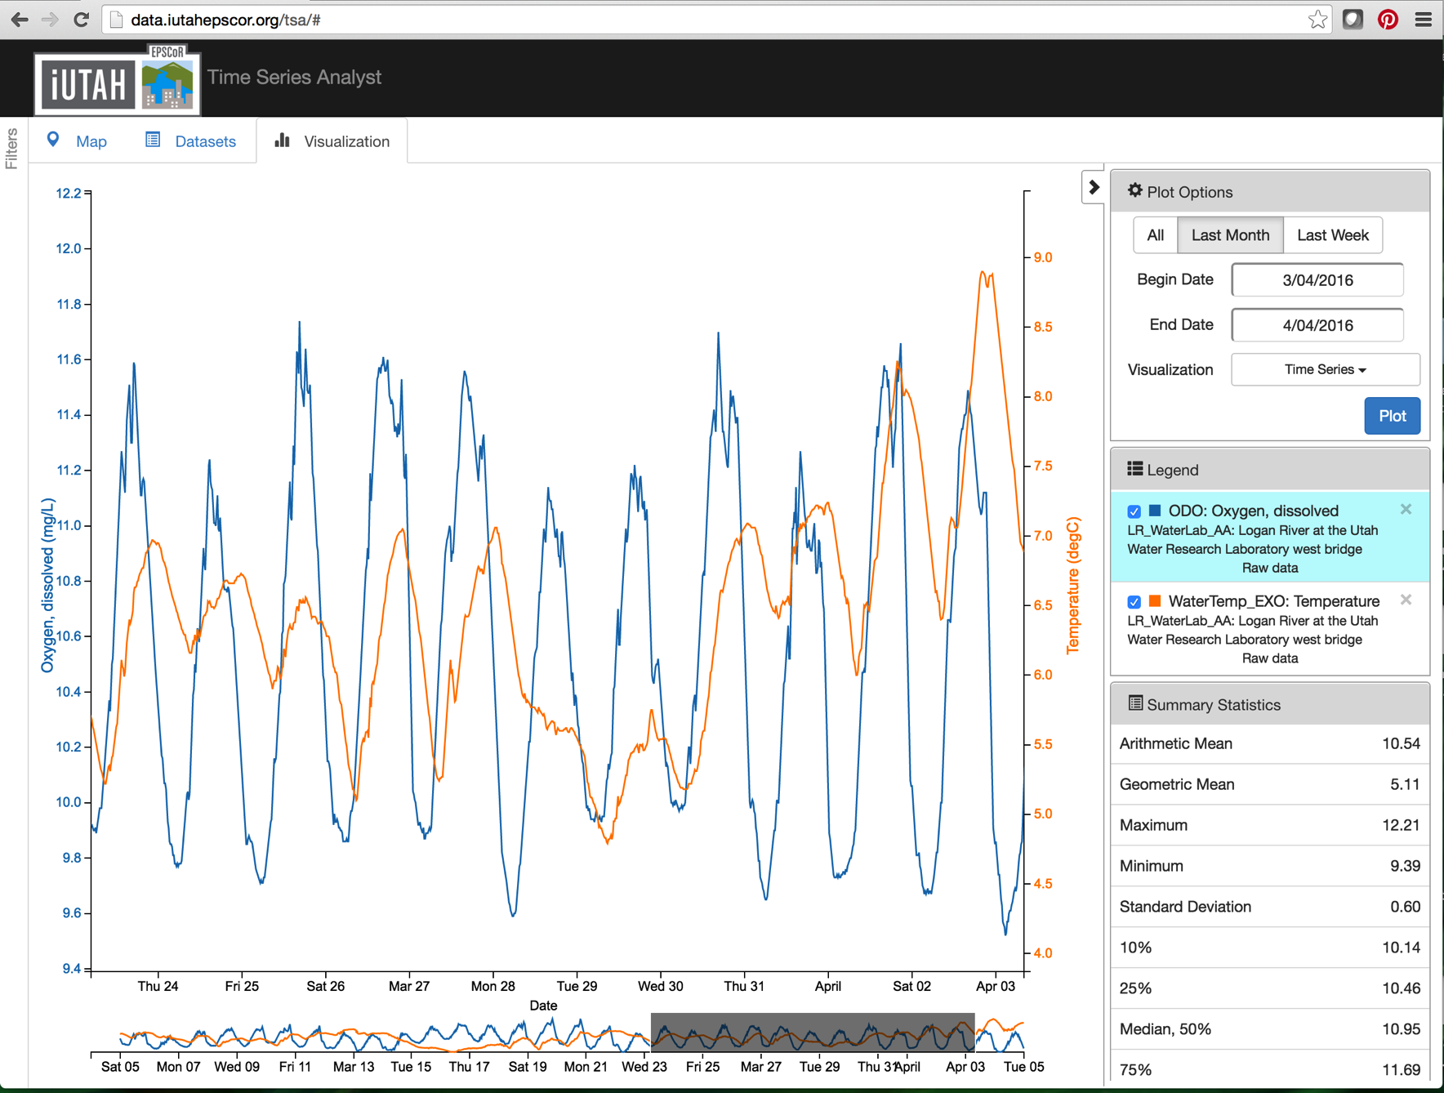
Web-Based Time Series Data Access and Visualization
Notes:
We have developed an enhanced web-based interface for time series visualization and data download.
Features include:
Google Maps interface for site selection
Faceted searching for narrowing the selection from a large set of data series- can apply filters for networks, sites, variables, variable categories, processing levels, etc.
Ability to download data series
Plotting interface includes multiple time series and different plot types

Slide 15
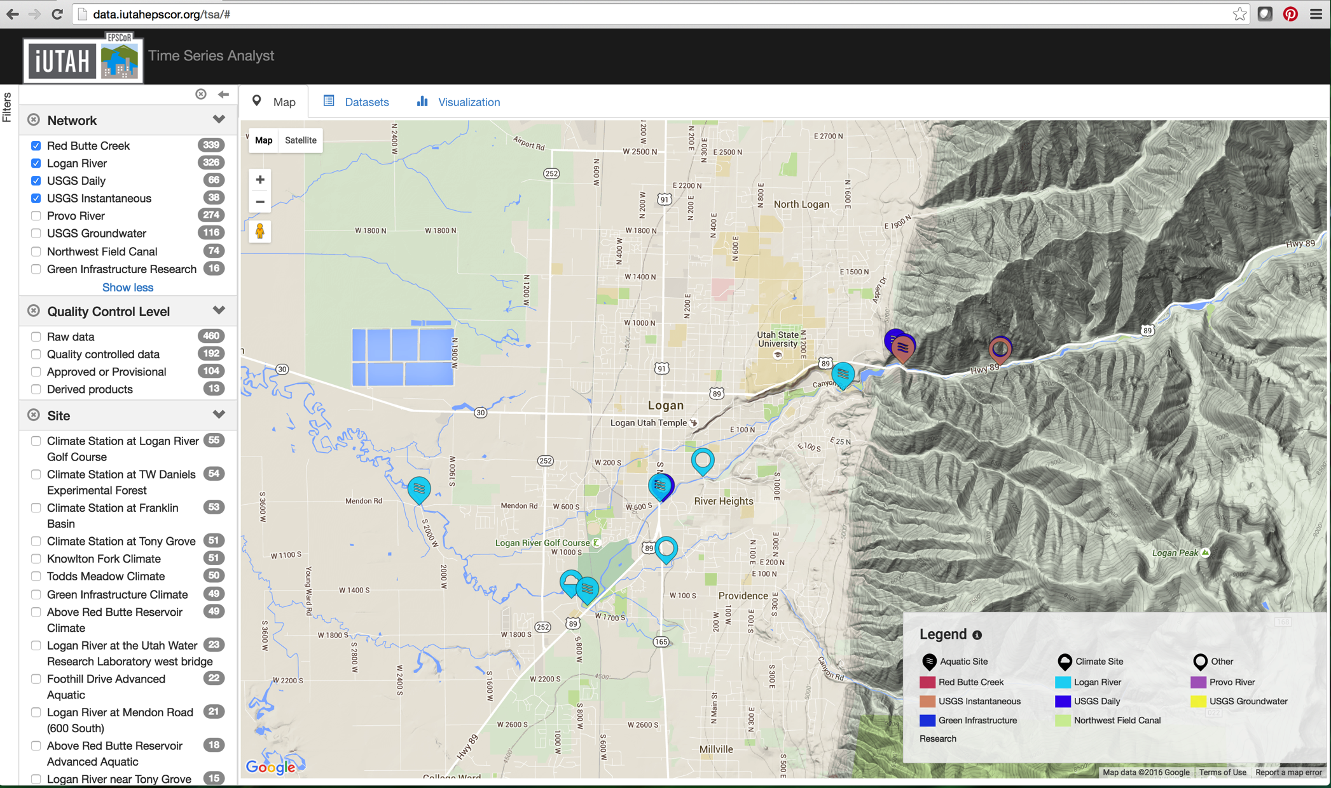
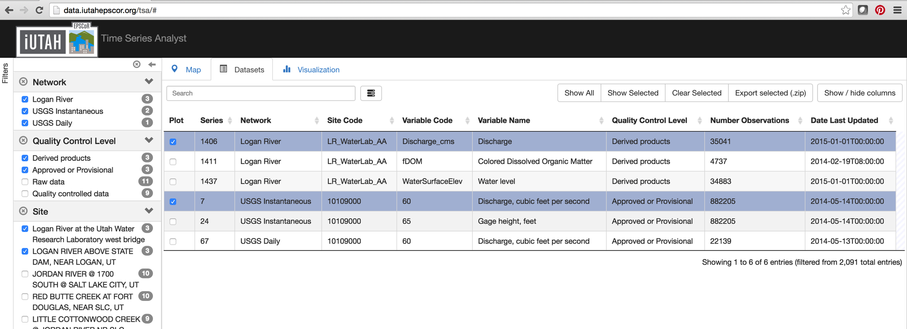
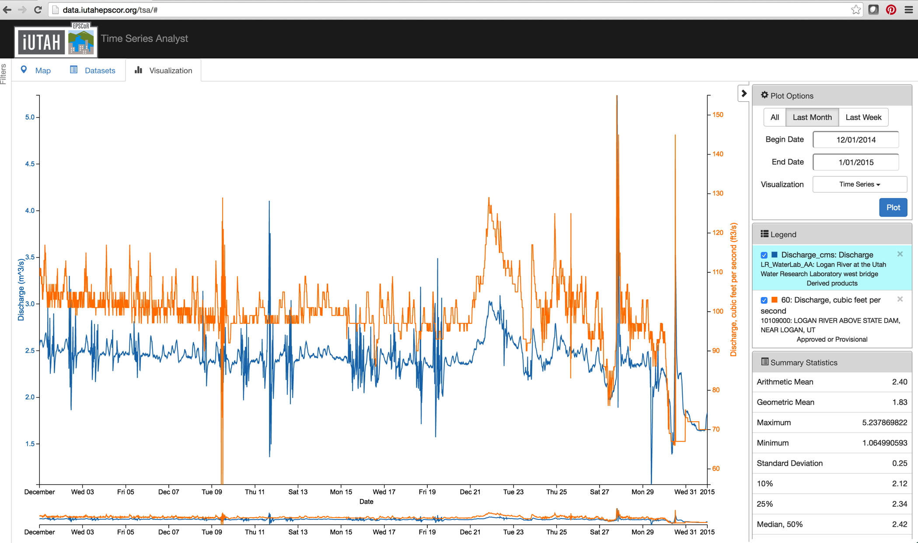
Web-Based Time Series Data Access and Visualization
Notes:
Uses web services to harvest data- can integrate any data that uses WaterOneFlow web services- e.g., we’ve integrated local USGS flow data into our deployment of the tool.

Slide 16
Sensor Data QAQC
Notes:
QA: commonly defined as any practices occurring prior to its collection. e.g., field protocols, calibration schedules and procedures, etc.
off of this workflow
QC: any practices implemented after the data are collected to achieve high data quality.
We have developed and deployed a Python-based software application for quality control post processing

Slide 17
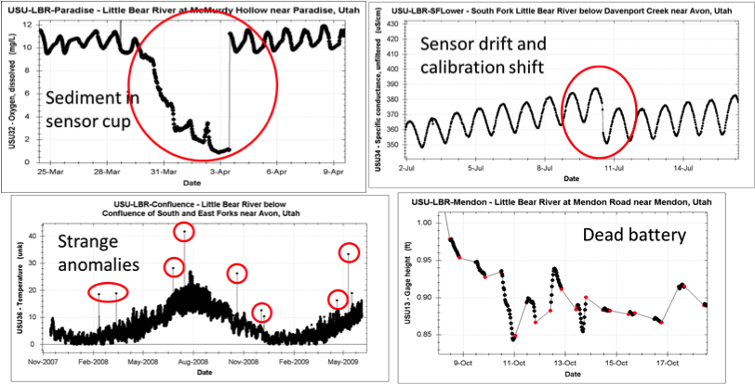
Sensor Data QAQC
Notes:
Sensor data commonly need corrections for anomalies, calibration shifts, and data flagging.

Slide 18
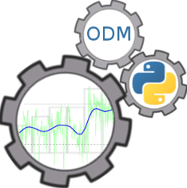
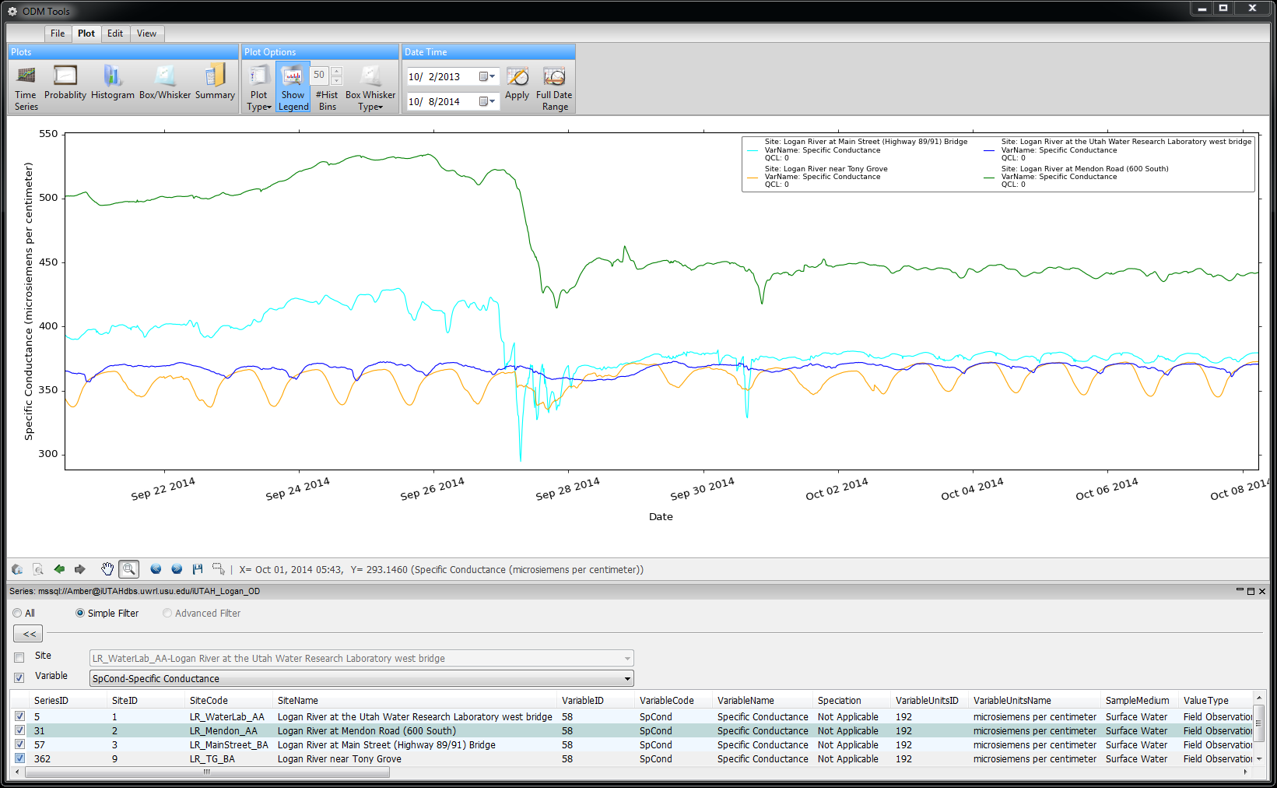
Sensor Data QAQC
Plot Display Options
Date Range Restrictions
Multiple Plot Types
Dynamic Zooming and Panning
Series Selection Filters
Time Series Selection
Notes:
ODM Tools Python:
Desktop client application for visualizing and managing data. Some of its features…

Slide 19
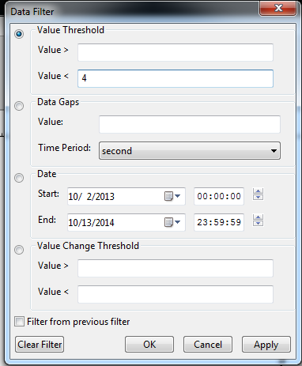
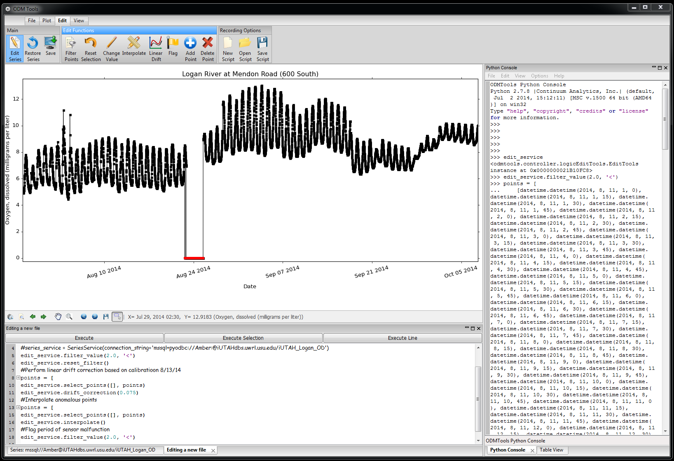
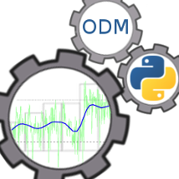
QAQC: Post Processing
Common Editing Tools
Filters on Data Points
Commit Edits to the Database
Python Code Console
Dynamic Data Editing Display
Python Script Editor
Notes:
It’s real focus is in the editing of data series.
Features a python code console and python script editor which records all data edits.
The script serves as a record for all of the processing edits made on the data. This script can be reviewed, making the process from raw data to quality controlled data traceable and also reproducible

Slide 20
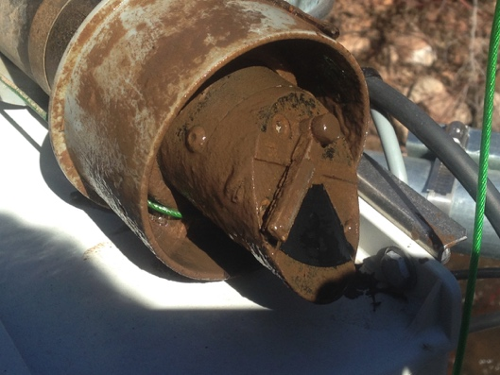
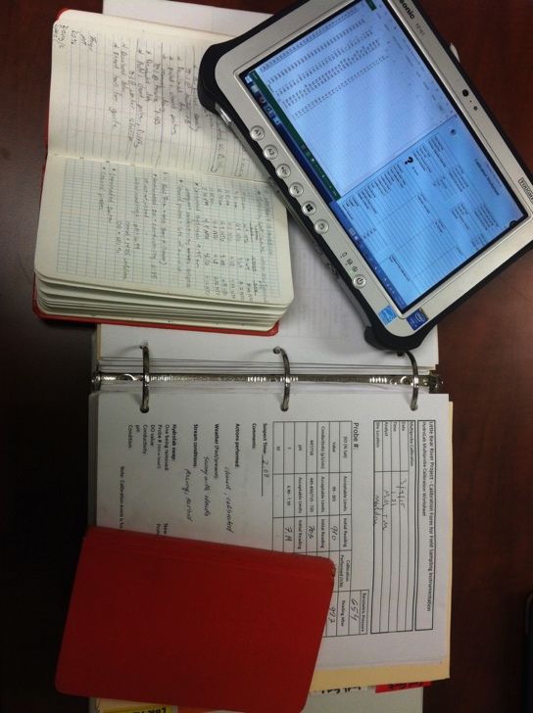






Managing Physical Infrastructure
What were the field conditions of our discharge measurement?
Has this turbidity sensor been serviced at the factory?
When was the last time we cleaned this sonde?
How did the other technician store calibration files?
Who programmed this datalogger?
Which sensors are deployed at this site? Who installed them?
How long has that battery been deployed?
Which standards did we use for that calibration?
When was the last time we changed desiccant?
What is the calibration history of this fDOM sensor?
Where are the field notes to reference for QC?
What were the field conditions of our discharge measurement?
Notes:
Networks conducting long term monitoring using in situ sensors need the functionality to track physical equipment as well as deployments, calibrations, and other actions related to site and equipment maintenance. The observational data being generated by sensors are enhanced if direct linkages to equipment details and actions can be made. This type of information is typically recorded in field notebooks or in static files, which are rarely linked to observations in a way that could be used to interpret results. However, the record of field activities is often relevant to analysis or post processing of the observational data.

Slide 21
Managing Physical Infrastructure
Notes:
The Equipment schema was designed as an extension to Version 2 of the Observations Model (ODM2).

Slide 22

Managing Physical Infrastructure
Notes:
The Equipment extension provides additional metadata specific to physical inventory (Equipment and Equipment Models) and associated actions (Calibrations, Deployments, Maintenance Actions).
The schema is implemented in a relational database system for storage and management.

Slide 23



Managing Physical Infrastructure
Notes:
To interact with the underlying database, we developed a web interface using Python Django and d3.
Site visits are created with calibrations, deployments, and other actions added as nested actions related to the site visit. The action type determines which attributes are necessary.
Site visit details and related actions can be queried and reviewed.
Deployment and calibration histories can be viewed by site.

Slide 24




Managing Physical Infrastructure
Notes:
The full equipment inventory can be searched with detailed views for each piece of equipment.
Deployment and calibration histories can be viewed for each piece of equipment.
Can view equipment associated with each person

Slide 25



Managing Physical Infrastructure
Notes:
For each instrument deployment, one or more result records are created, linking physical infrastructure to observations.

Slide 26


Open Source Code
WEBTSA – Time series data visualization
https://github.com/UCHIC/WEBTSA
ODM Streaming Data Loader
https://github.com/ODM2/ODM2StreamingDataLoader
ODM Tools Python – Sensor Data Management
https://github.com/ODM2/ODMToolsPython
ODM2 Sensor – Sensor equipment management
https://github.com/UCHIC/ODM2Sensor
Notes:
All of the software and tools that we have developed are open-source. You can access the software via our github repositories. We also welcome contributions.
Each component of our data management workflow can be implemented on its own depending on the needs of the network.
Note that most of these products are still being actively developed. We are in the process of growing the software ecosystem that will be used around ODM2- some of this means converting from ODM 1 compatibility to ODM 2.

Slide 27
Conclusions
Researchers are using in situ sensors at multiple sites more commonly resulting in large datasets
Much of the data management workflow can (and should!) be automated
Visualization access can be made broadly available
Reproducible QC removes the requirement that only one person perform post processing and increases confidence in the process
The tools described have sped the time from collection to analysis and facilitate sharing and publication of the data
Sustainability is enhanced by using community-developed standards and open-source tools
Data reusability facilitated by ability to access data and metadata programmatically
Data Available at http://data.iutahepscor.org
Notes:
We’ve been able to increase the quality of our sensor-based data products by:
Automating much of our data mgmt tasks- which is essential for the volume of data generated by in situ networks.
Making visualization and data access broadly available.
We’ve been able to make our QC reproducible and tracceable- increase confidence in the process
We’ve also been able to to track sensors across institutions, maintaining a consistent record despite personnel changes, and a reference for performing quality control on observational data.
These last points-
Community developed standards with open source and documented tools improve sustainability of the data and the tools.
Accessing data and metadata programmatically make data more reusable

Slide 28



Questions?
Amber Jones amber.jones@usu.edu
Jeff Horsburgh jeff.horsburgh@usu.edu
http://data.iutahepscor.org
This project is funded by National Science Foundation grant EPS-1208732.
Any opinions, findings, and conclusions or recommendations expressed in this material are those of the author(s) and do not necessarily reflect the views of the National Science Foundation.

